Slide 1
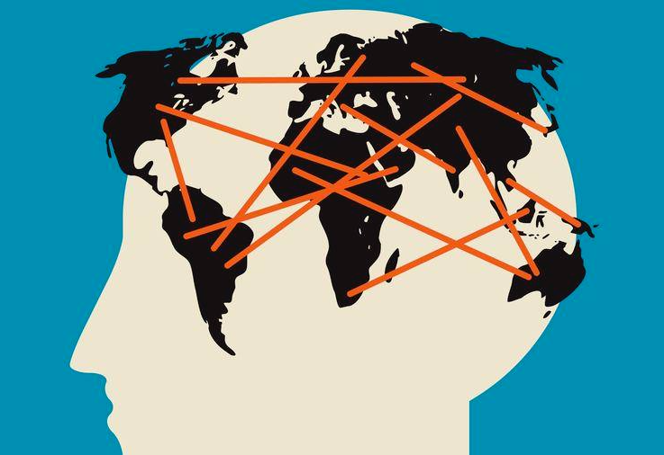


Global Mental Health
Facts and Fads in a Personal Journey
Artin A. Mahdanian, MD, MSc
Psychiatry Resident, PGY-5
Grand Rounds MUHC
Date: Oct 25, 2019

Slide 2

Disclosures
No financial conflict of interest
    FRQS award for MSc
    Travel awards for APA conferences (APA Diversity Fellowship)
    WHO lunch vouchers ☺
    All internship travels on a Line of Credit ☹
It does not represent any organizational views
I am not yet a GMH expert but getting there!

Slide 3
Objectives
At the conclusion of this session, the participant will be able to:
Understand the rationale for GMH movements
Appreciate the global picture of Mental Health conditions and its challenges
Learn about the key projects (situational analysis & implementations) in GMH
Appreciate global human rights violations in mental health
Discuss some critical views of GMH

Slide 4


My Journey
MD Tehran University
International Affairs Consultant, Minister of Health, Iran
GP: 1-Baluchistan, 2- Armenian Clinic, 3- Train physician
MSc and then residency at McGill University
Internship: World Health Organization, Geneva, Switzerland
Internship: Center for Global Mental Health, London School of Hygiene and Tropical Medicine, London, UK

Slide 5
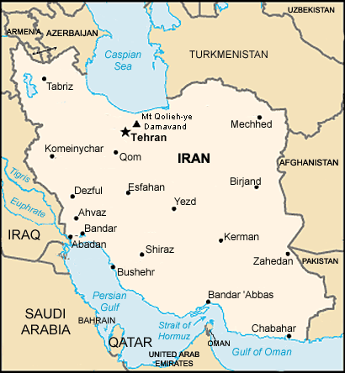


Slide 6
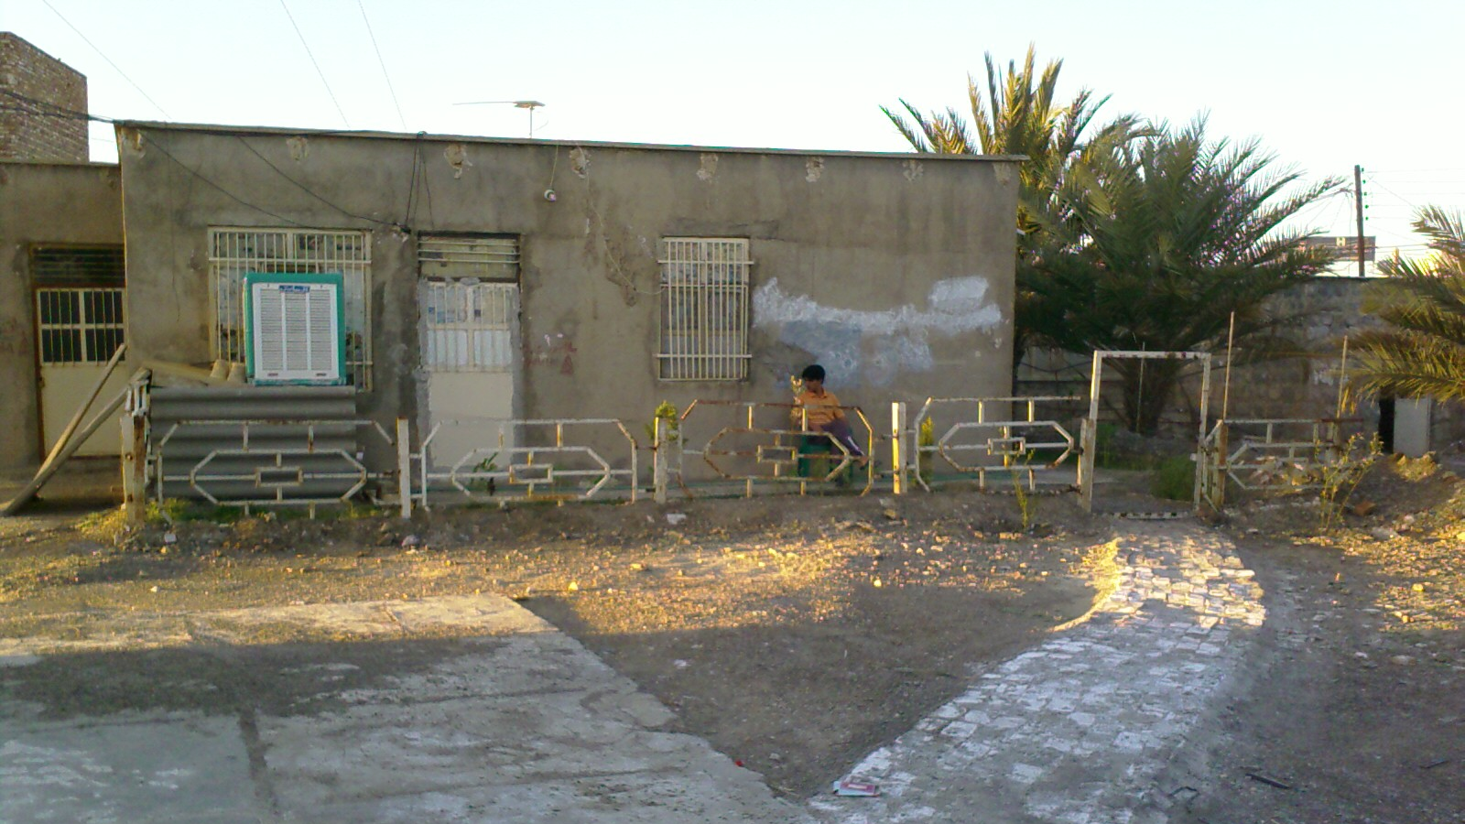
Zaboli Health Clinic, Baluchistan, Iran

Slide 7
Global Mental Health

Slide 8
Mental Health
“a state of well-being
the individual realizes their own abilities
can cope with the normal stresses of life
can work productively and fruitfully
able to make a contribution to his or her community”
(WHO, 2007)

Slide 9
MH History
Concerns about mental health conditions have been circulating the globe for thousands of years
Egypt
China
India
Greece
Iran (Avicenna 980-1037)
ETC.

Slide 10
Rise of Institutional Care
First general hospitals in middle east in the 8th century (around the same time in Europe)
8th to13th century, mental institutions spread in Europe
First records in of asylums in 14th century
    16th century in Constantinople describes mental patients being beaten, chained, and displayed for ‘public amusement’

Slide 11
Colonial Psychiatry
With colonialism came the spread of western psychiatry and the establishment of mental asylums
18th – 20th century, British authorities established asylums in East Asia and Africa

Slide 12
Deinstitutionalization
The institutional care effectively came to an end in the 1950’s.
Result of several factors:
  Civil and human rights movements
  Awareness of the negative effects of long-term institutionalization
  Expense of institutional care
  Belief in the efficacy of treatments
  Discovery of Chlorpromazine (1951), the first effective anti-psychotic medication ( Paul Charpentier – Henri Laborit – Heinz Lehmann)
Notes:
See pp. 539-540, Grob GN. 2008. The Transformation of American Psychiatry: From Institution to Community, 1800–2000. Wallace ER & Gach J, Eds. New York: Springer, 533-554.

Slide 13
Results of Deinstitutionalization
Discharged without planning or enough resources in the community
Trans-institutionalization
  Forensic hospitals
  Prisons
Homelessness
  The neglect and abuses that characterized institutional care of the past have been replaced by neglect and abuse in the community!

Slide 14
MH Treatments
Trephination
Bloodletting
Isolation and Asylums
Insulin Coma Therapy/Metrazol Therapy
Lobotomy (Egas Moniz, Noble Prize 1949)/Psychosurgery
Exorcism/Prayers/Herbal/Traditional medicines
ECT/rTMS/Light Therapy/TDCS/DBS
Psychopharmacology
Psychotherapy

Slide 15
Global MH: The Terminology
1982: first use of the term “Global MH”:
  Are we for mental health as well as against mental illness? The significance for psychiatry of a global mental health coalition (Brody 1982)
Before this Global MH used to denote overall level of mental health
2001: Global mental health: its time has come (Satcher, US Surgeon General)
Notes:
1982: First use of the term:
Are We for Mental Health as Well as Against Mental Illness? The Significance for Psychiatry of a Global Mental Health Coalition (Brody 1982)
Prior to 2001:
GMH used to denote overall level of stress in an individual
2001:
Global Mental Health: Its Time Has Come (Satcher)
2007:
The Lancet series
2010:
A New Global Health Field Comes of Age (Patel & Prince)
2014:
Why Mental Health Matters to Global Health (Patel)

Slide 16
Global Aspect of MH
Global Mental Health is a part of Global Health
Global health is the health of populations in a global context.
It has been defined as "the area of study, research and practice that places a priority on improving health and achieving equity in health for all people worldwide“ from public health and international health, which, in turn, evolved from hygiene and tropical medicine.
Global Health
Emphasises common, trans-border agendas
Equity and fairness key
Very multidisciplinary
Interested in HICs and LAMICs
International Health
Interest in health in other countries
Often charity-based
Colonial, Tropical Medicine
Main emphasis on low income settings

Slide 17
Pillars of GMH/GH/PH
(1) based on data and evidence
(2) focus on populations rather than individuals
(3) goal of social justice and equity
(4) emphasis on prevention rather than curative care

Slide 18
MH importance in global context:
Mental health is as important as physical health to the overall well-being of individuals, societies and countries.
Yet only a small minority of the 970 million people (about 20% of world population) with diagnosable mental or behavioral conditions are receiving treatment.
Institute of Health Metrics and Evaluations (IHME), 2017

Slide 19
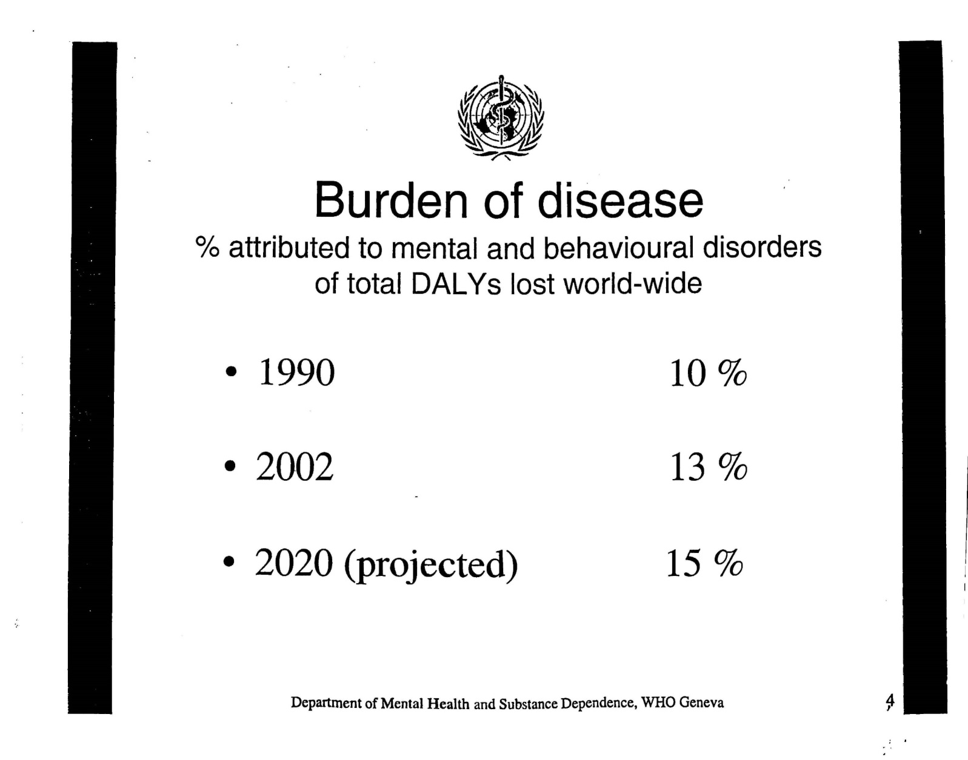
Depression:
Second most costly disease worldwide (DALYs) 2020

Slide 20
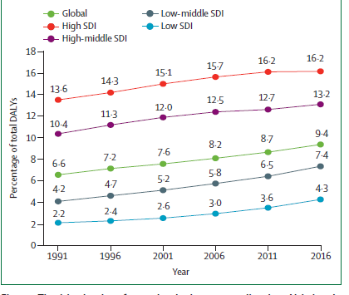

Slide 21
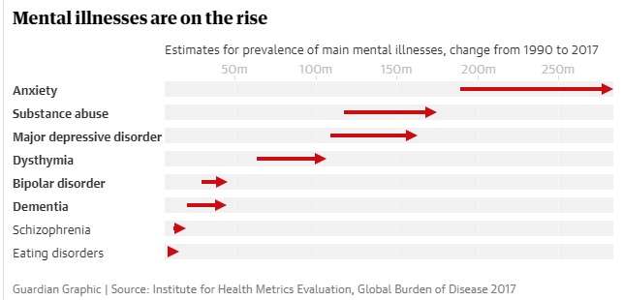

Slide 22
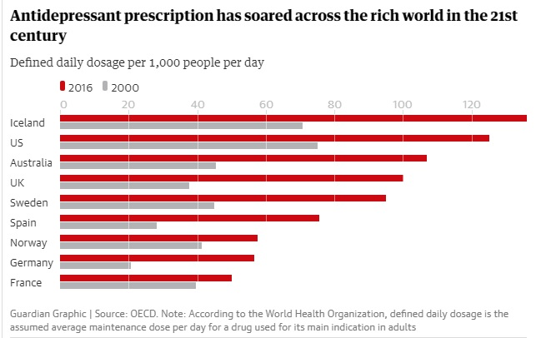

Slide 23
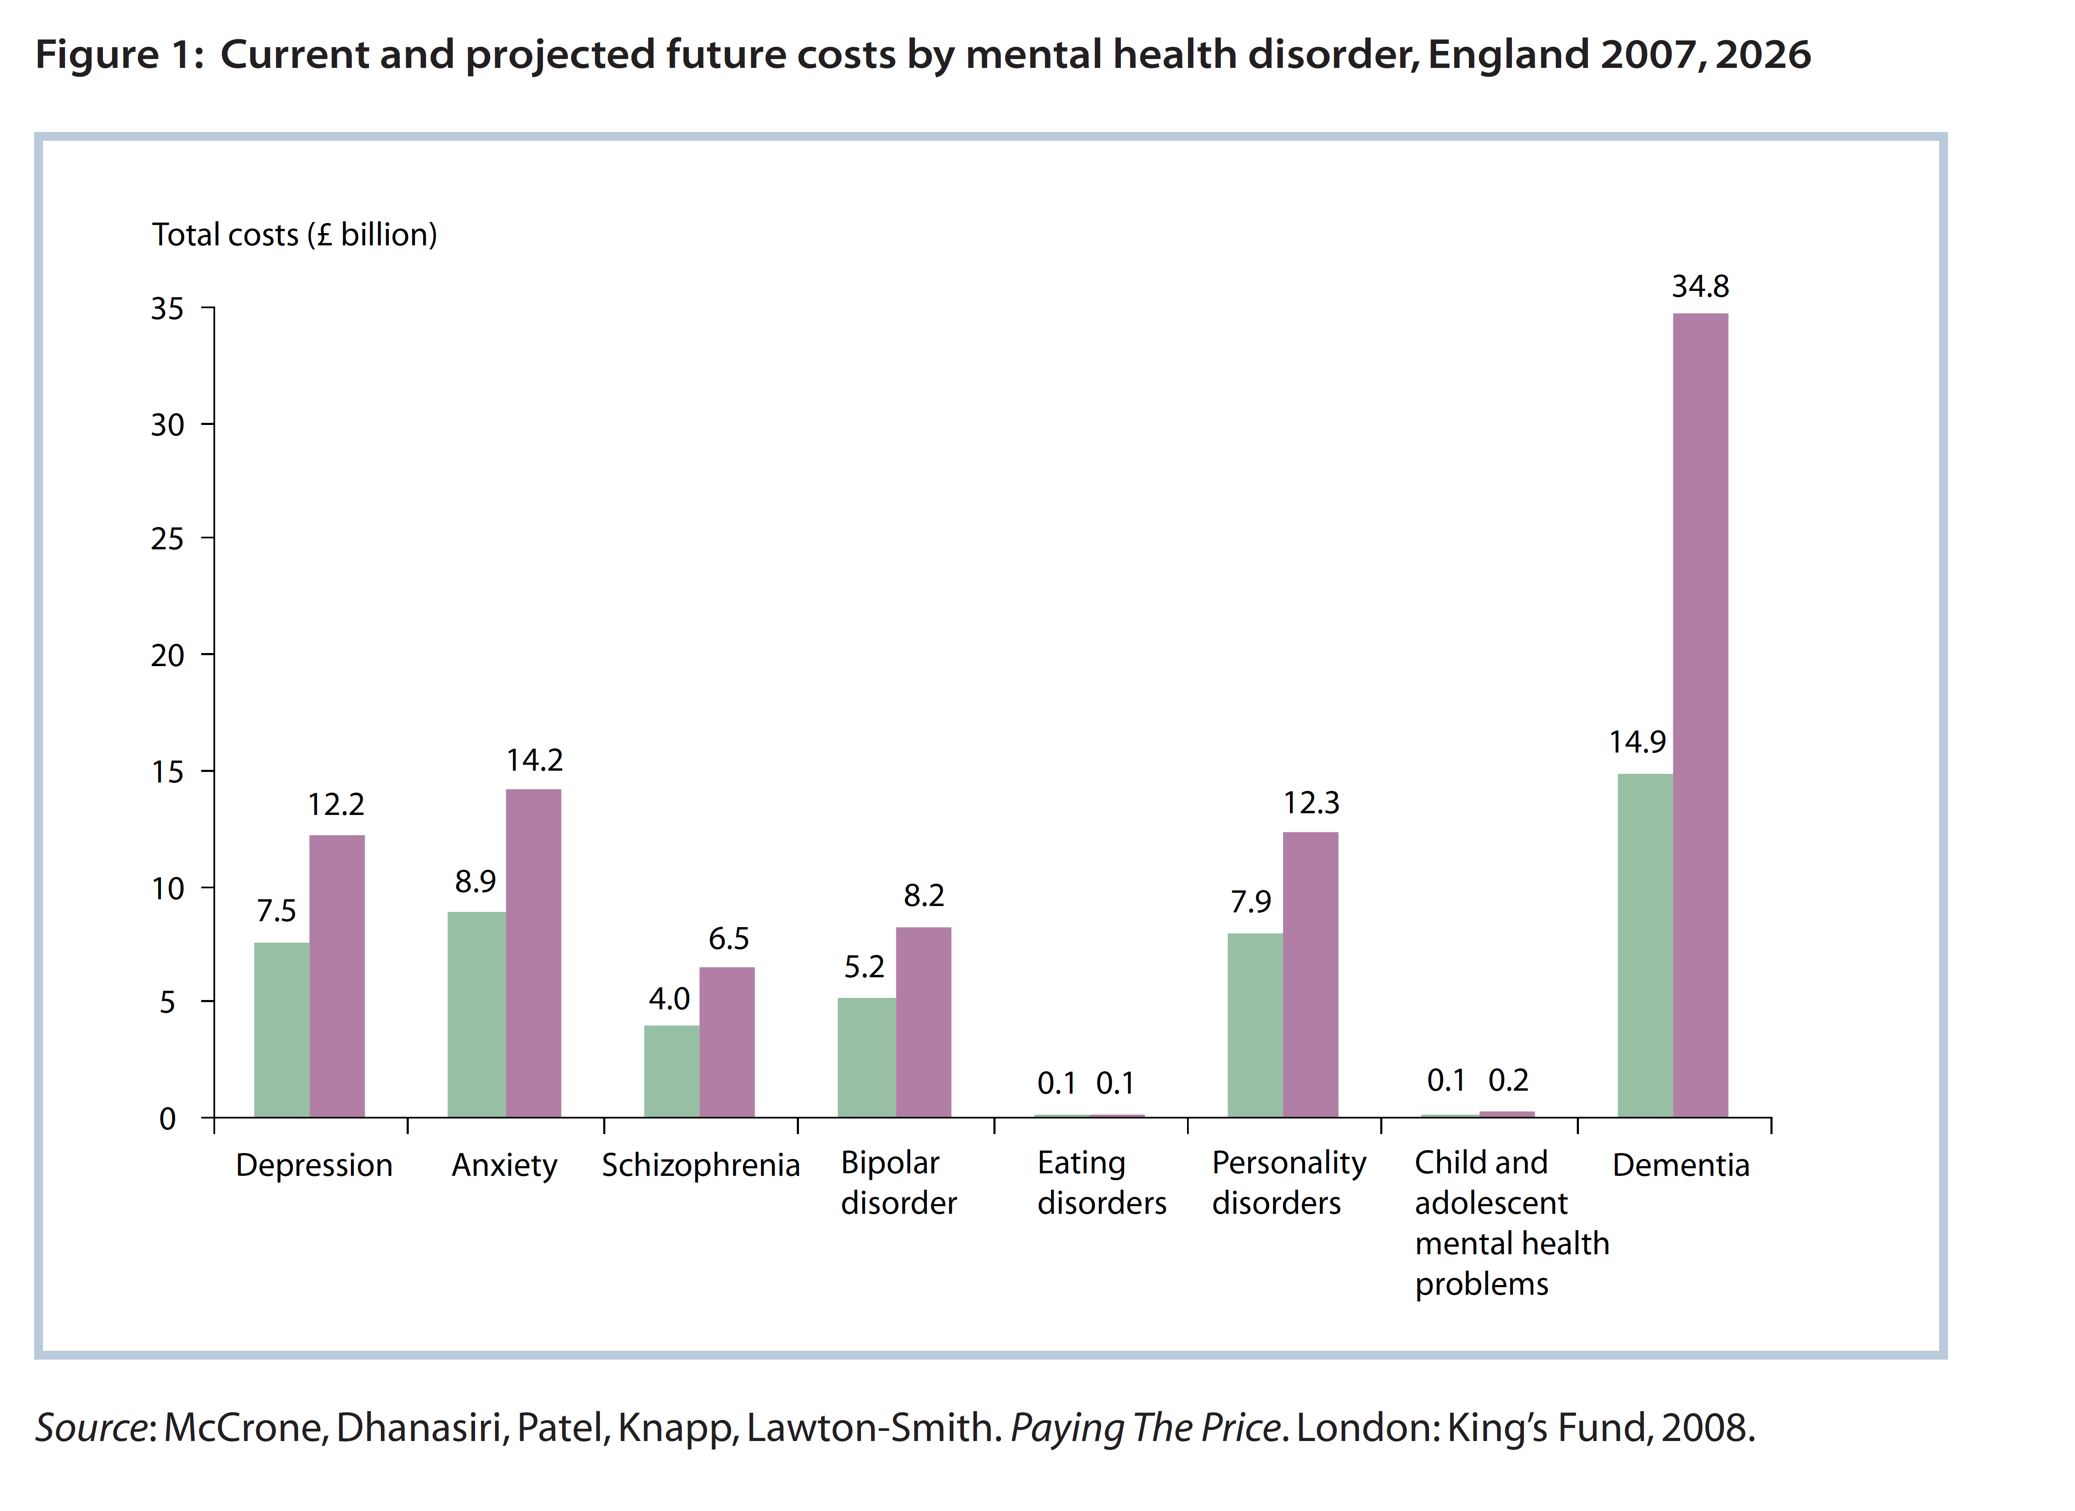

Slide 24
Mental Health Costs
The World Economic Forum estimates:
Chronic diseases will cost the global economy about $ 50 trillion between 2010 and 2030.
One third ($16 trillion) is attributed to mental health conditions.
  - Most of this cost is due to persistent disability, social care, and lost productivity, less due to direct treatment, or prevention/promotion

Slide 25
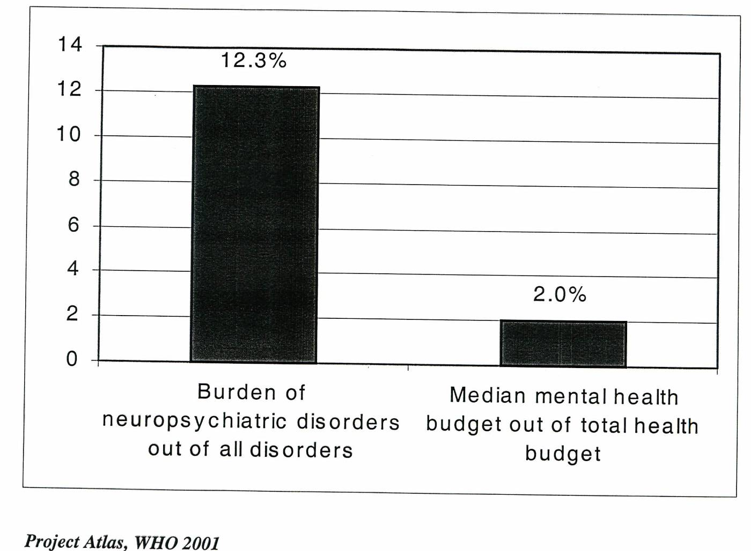
Burden vs. Resources

Slide 26
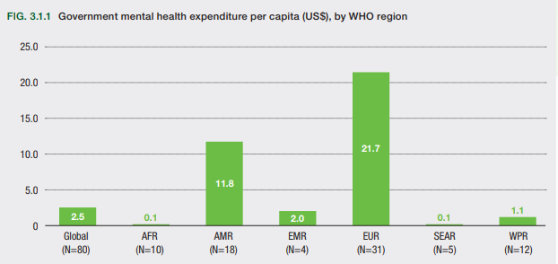
MH is Globally Neglected
WHO MH Atlas 2018

Slide 27
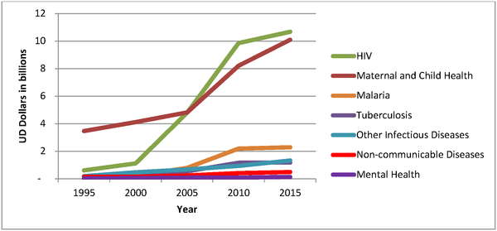
Global Health Funding, 1995 to 2015
Charlson FJ, Dieleman J, Singh L, Whiteford HA (2017) Donor Financing of Global Mental Health, 1995—2015: An Assessment of Trends, Channels, and Alignment with the Disease Burden. PLOS ONE 12(1): e0169384. https://doi.org/10.1371/journal.pone.0169384
http://journals.plos.org/plosone/article?id=10.1371/journal.pone.0169384

Slide 28
Consequences of low funding:
Lack of resources
Treatment Gap:
  In high income countries, up to 50% go without treatment
  Up to 90-95% in low- & middle-income countries
Evidence-based practices are not readily available
Human rights abuse:
  Often in the very institutions that are responsible for care

Slide 29
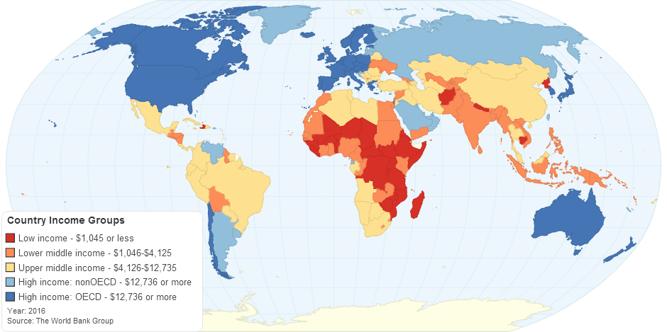
Global Disparities
>80% of the world’s population live in LMIC,
>90% of MH resources are in high-income countries (WHO, 2010).

Slide 30
Interest in Primary Care
WHO expert committee 1974:
  In the developing countries, trained mental health professionals are very scarce indeed. Clearly, if basic mental health care is to be brought within reach of the mass of the population, this will have to be done by non-specialized health workers…working in collaboration with, and supported by, more specialized personnel.

Slide 31


Notes:
Eliot Sorel’s volume, 21st Century Global Mental Health (2012) has 5 sections, 16 chapters, 400 pp. In my reading, this collection does take children and families into consideration. My wish is to maintain and increase this key sensibility. My chapter in this volume addresses GMH from a child, adolescent and family perspective:
Section 2: Determinants of Health and Mental Health
Family, psychosocial, and cultural determinants of health (Di Nicola, 2012)

Slide 32
Global Mental Health
GMH is an international, interdisciplinary, culturally-sensitive, and multi-sectoral domain which promotes mental health and wellbeing, the right to health, and equity in health for all. It encourages healthy behaviours and lifestyles; is committed to preventing and treating mental health conditions especially for vulnerable populations (e.g., in settings of poverty, conflict, calamity, and trauma and in low- and middle income countries); and seeks to improve policies and programs, professional practices and research, advocacy and awareness, and social and environmental factors that affect health and wellbeing.
(Kelly O’Donnel)

Slide 33
Global Mental Health:
  Evidence-based psychiatry
  Transcultural Psychiatry
  Social psychiatry and social determinants of health
  Country-specific conditions
  Epidemiology of mental health conditions
  Health policy and politics
  Health care systems
  Human rights issues
  Public health, Anthropology, Health economics

Slide 34
Global Mental Health
Pioneers
Vikram Patel
Shekar Saxena
Pamela Collins
Eliot Sorel
Julian Eaton
James Griffith
Critics
China Mills
Ethan Watters
Vincenzo Di Nicola
Graham Thornicroft
Samuel Okpaku
Gabriel Ivbijaro
Brandon Kohrt
Duncan Pederson
Laurence Kirmayer
Many Others

Slide 35
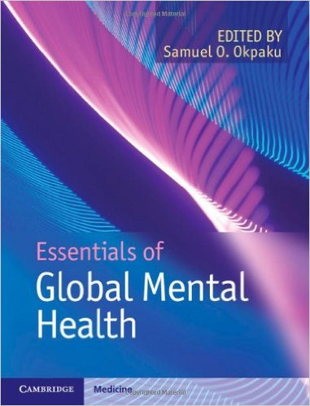
Notes:
Samuel Okpaku’s (2014), Essentials of Global Mental Health, has 8 sections, 44 chapters, 465 pp. Both children and family relationships are addressed, with some gaps.

Slide 36
GMH Focus
Primary care, community & collaborative care (Infrastructures)
Early detection, intervention, psycho-education (Recovery)
Mental health financing/policy (Funding)
Quality of care (Evidence-based)
Ethics and human rights
Stigma reduction

Slide 37
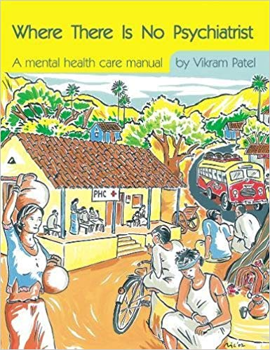

Slide 38
GMH journey so far

Slide 39
No health without mental health
Resources for mental health: scarcity, inequity, and inefficiency
Treatment and prevention of mental disorders
Mental health systems, policies
Call to action

Slide 41
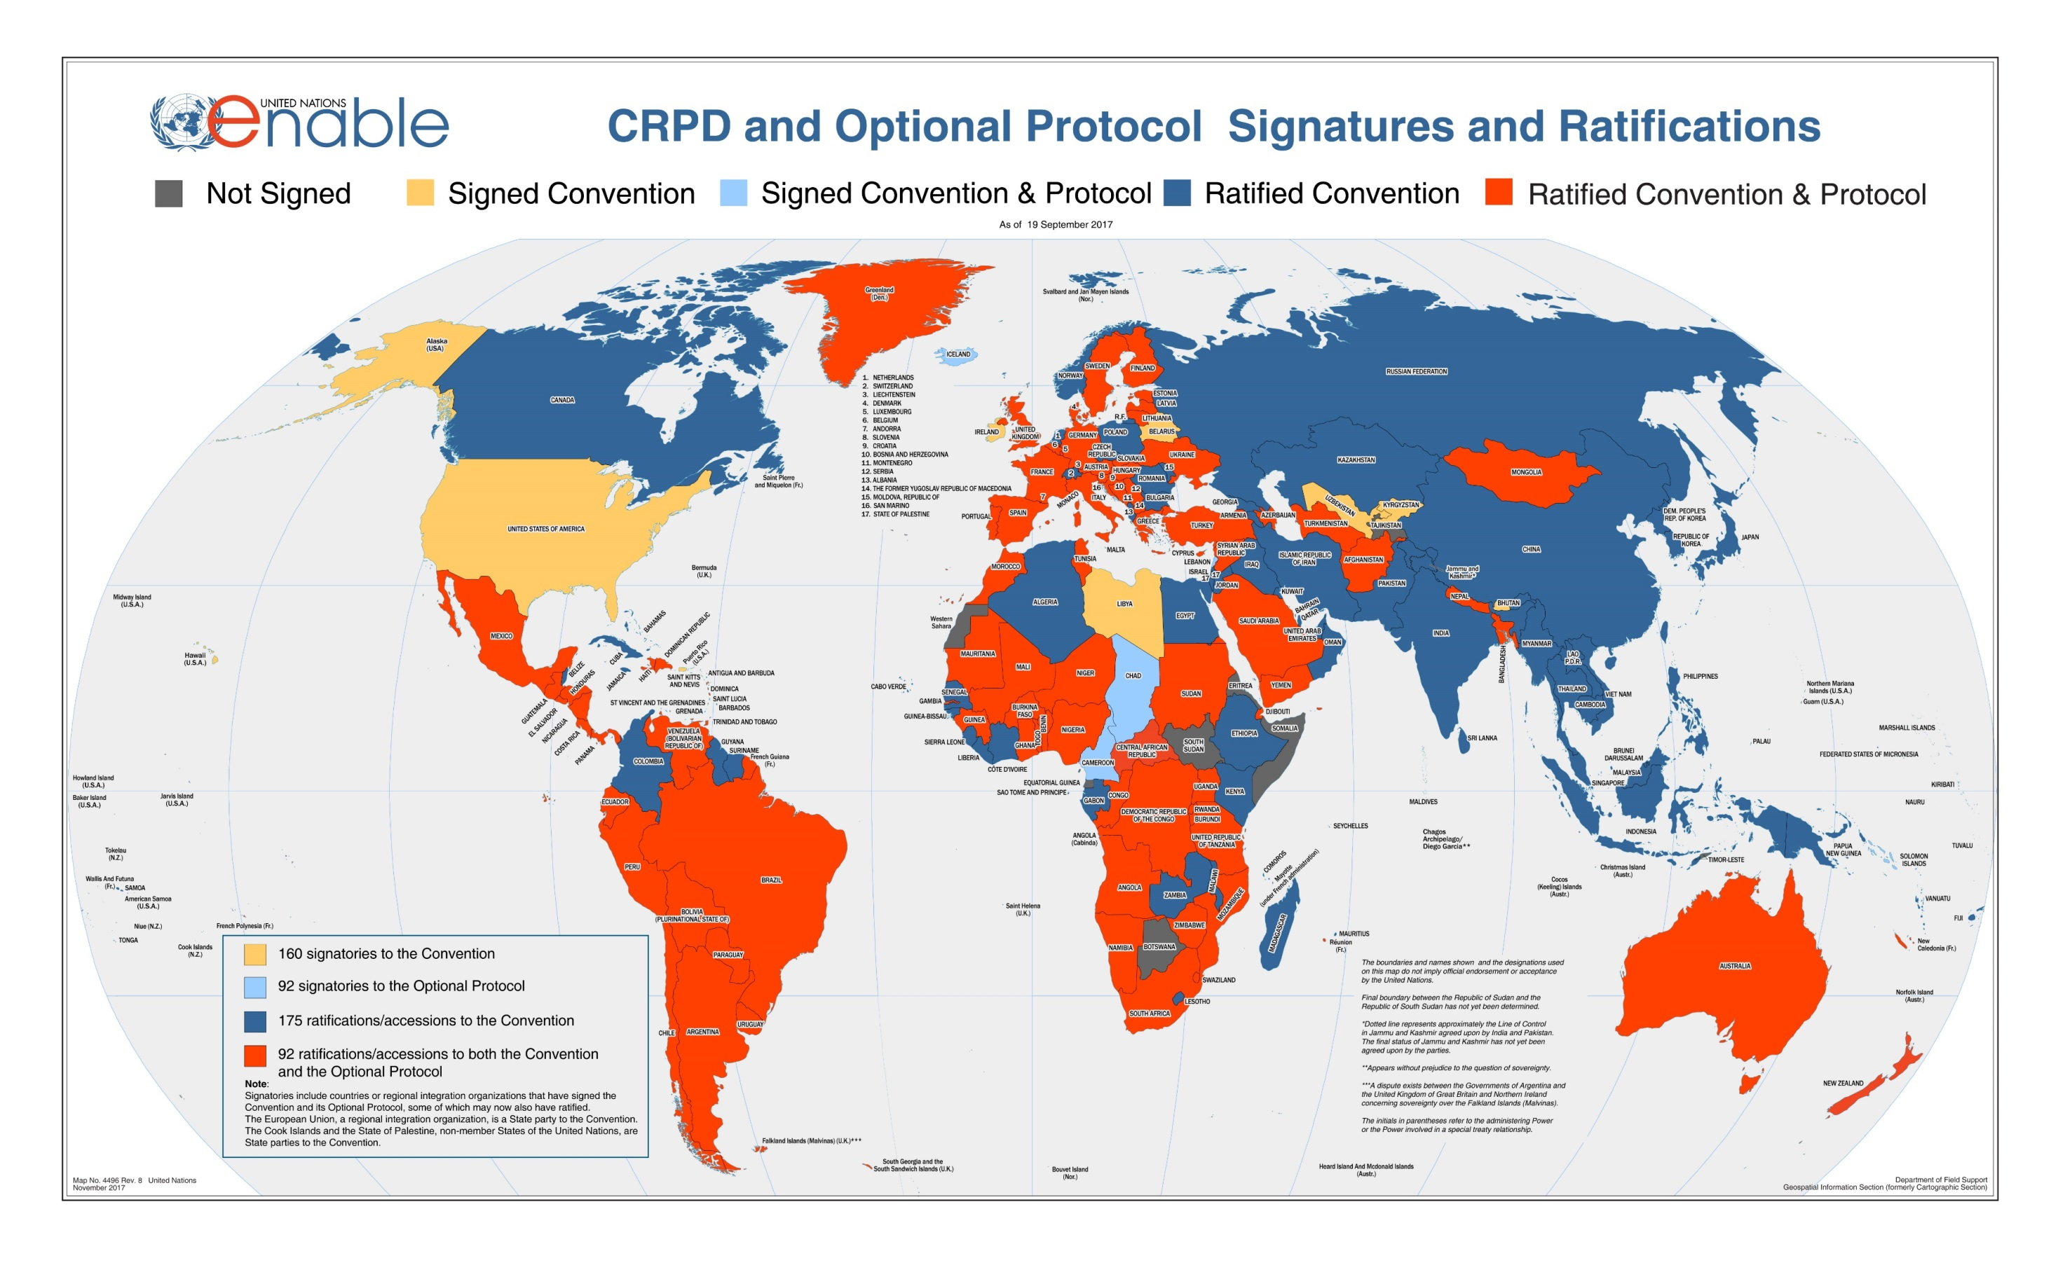

Slide 42


Slide 43
The WHO Mental Health Gap Action Program (mhGAP) aims at scaling up MH services for countries especially with low- and middle-income (LMICs)
To achieve higher coverage of key interventions

Slide 44
Priority Conditions
Depression
Psychosis
Epilepsy
Child and adolescent mental disorders
Dementia
Disorders due to substance use
Self-harm/suicide
Other significant mental health complaints

Slide 45
mhGap Packages
Intervention Guide
(like The mental health gap – intervention guide, mhGAP-IG)
  Management/prevention of each priority condition
  based on evidence of effectiveness and feasibility of interventions
  Will need to be adapted for countries, regions on basis of prevalence and burden, cost, feasibility, and acceptability of the interventions

Slide 46
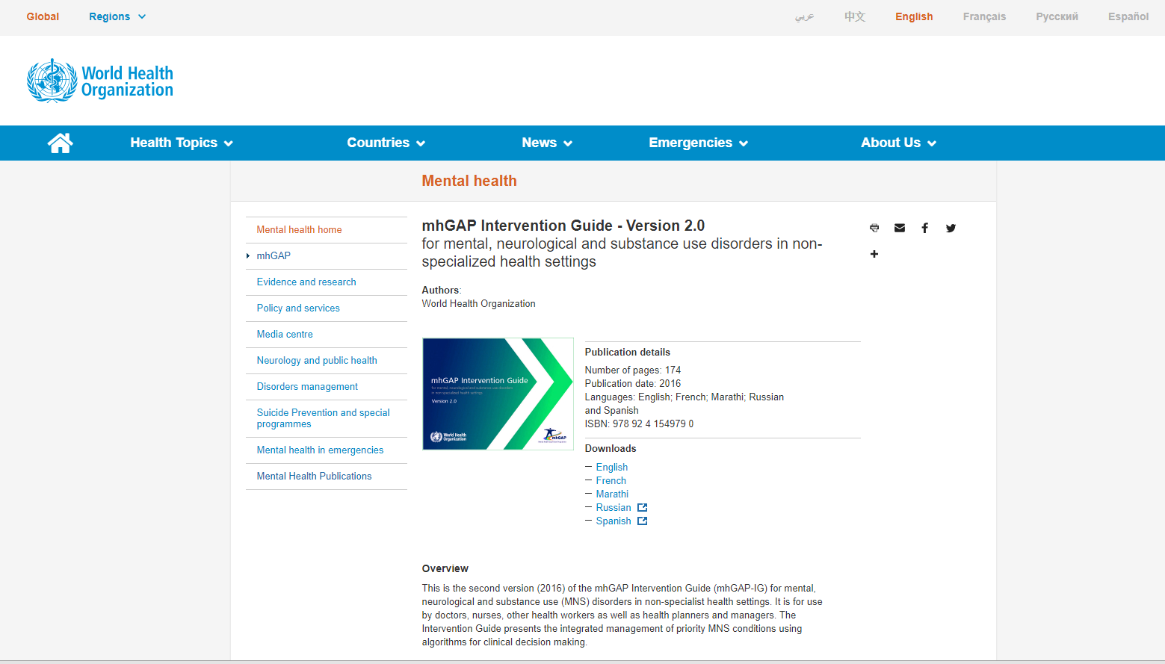

Slide 47
Grand Challenges in GMH, 2011
US National Institute of Mental Health (NIMH)
In partnership with:
  London School of Hygiene and Tropical Medicine (LSHTM)
  Global Alliance for Chronic Diseases
  Welcome Trust
  Mclaughlin‐Rotman Center for Global Health
Notes:
https://grandchallengesgmh.nimh.nih.gov/

Slide 48
Top Challenges
Integrate MH services into routine primary health care
Reduce the costs and improve the supply of medications
Provide effective & affordable community-based care/rehab
Improve access to evidence-based care for children
Strengthen MH training for all health-care personnel

Slide 49

Innovations in global mental health driven by grand challenges
Bold ideas with big impact
Committing up to $10m
Funded the Mental Health Innovation Network (MHIN).
Notes:
http://www.grandchallenges.ca/grand-challenges/global-mental-health/
Funded the Mental Health Innovation Network

Slide 50


Slide 51
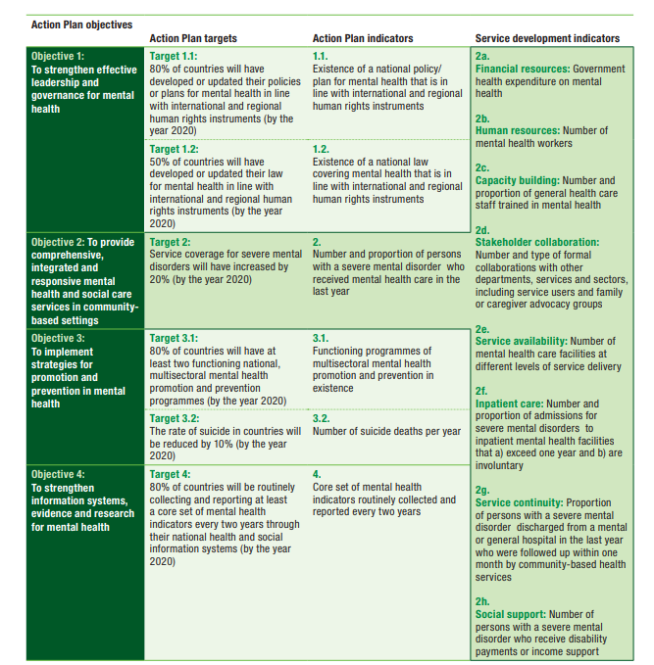
Objectives
Leadership/governance
Community-based MH care
Promotion/Prevention
Programs
Information systems

Slide 52
Principles
Universal health coverage
Human rights
Evidence-based practice
Life course approach (prevention, promotion, treatment)
Multi-sectoral and transcultural approach
Empowerment of persons with mental disorders and psychosocial disabilities (recovery model)
Notes:
Image: WHO/Chris de Bode

Slide 53
Critical Issues
Deinstitutionalization
  Access to community care (COMMUNITY SETTINGS)
  Involvement of general care (GENERAL HOSPITAL)
User involvement
Child mental health care
Integration between various levels of care
Integration between health and social care
Financing

Slide 54


Slide 55
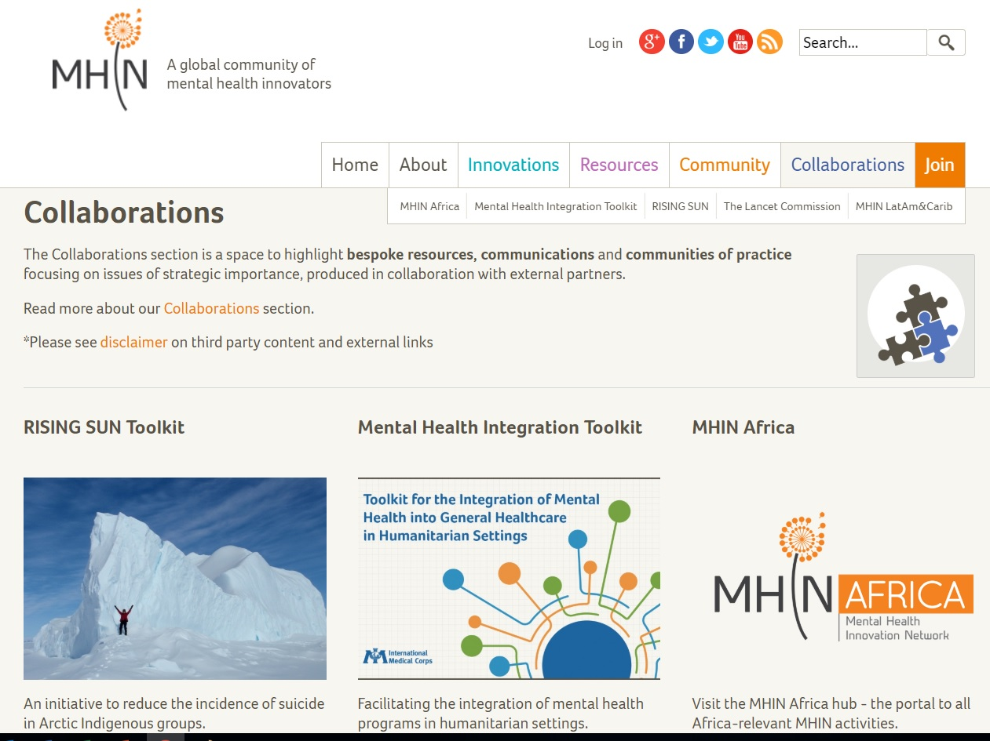
Knowledge Exchange Platforms
https://www.mhinnovation.net/

Slide 56
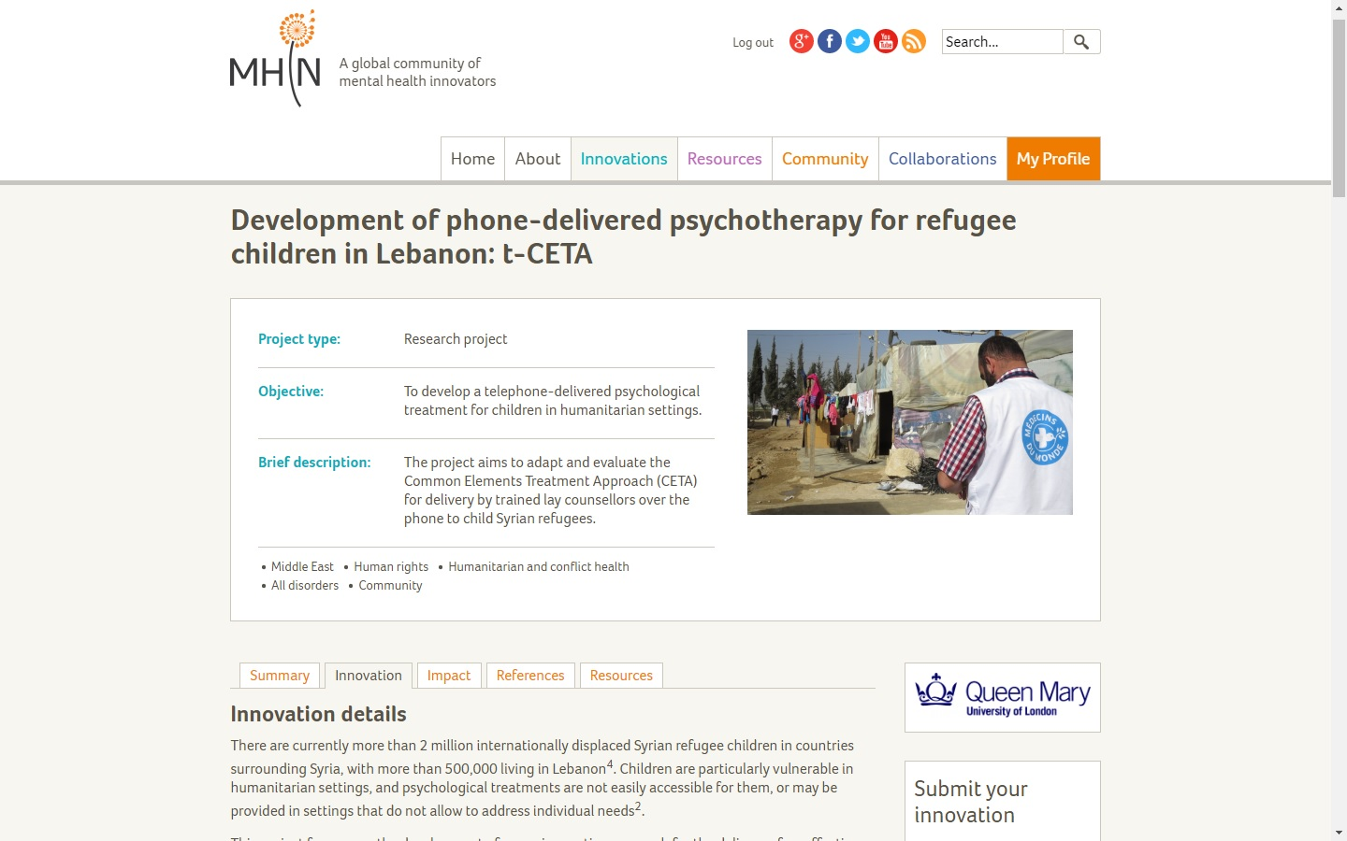

Slide 57
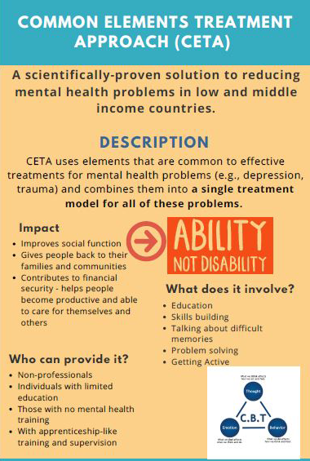
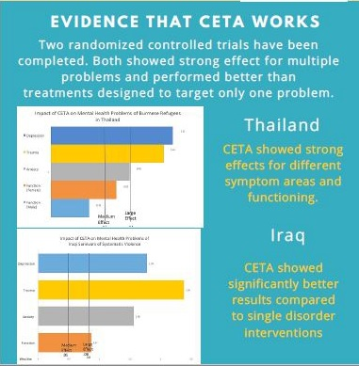

Slide 58
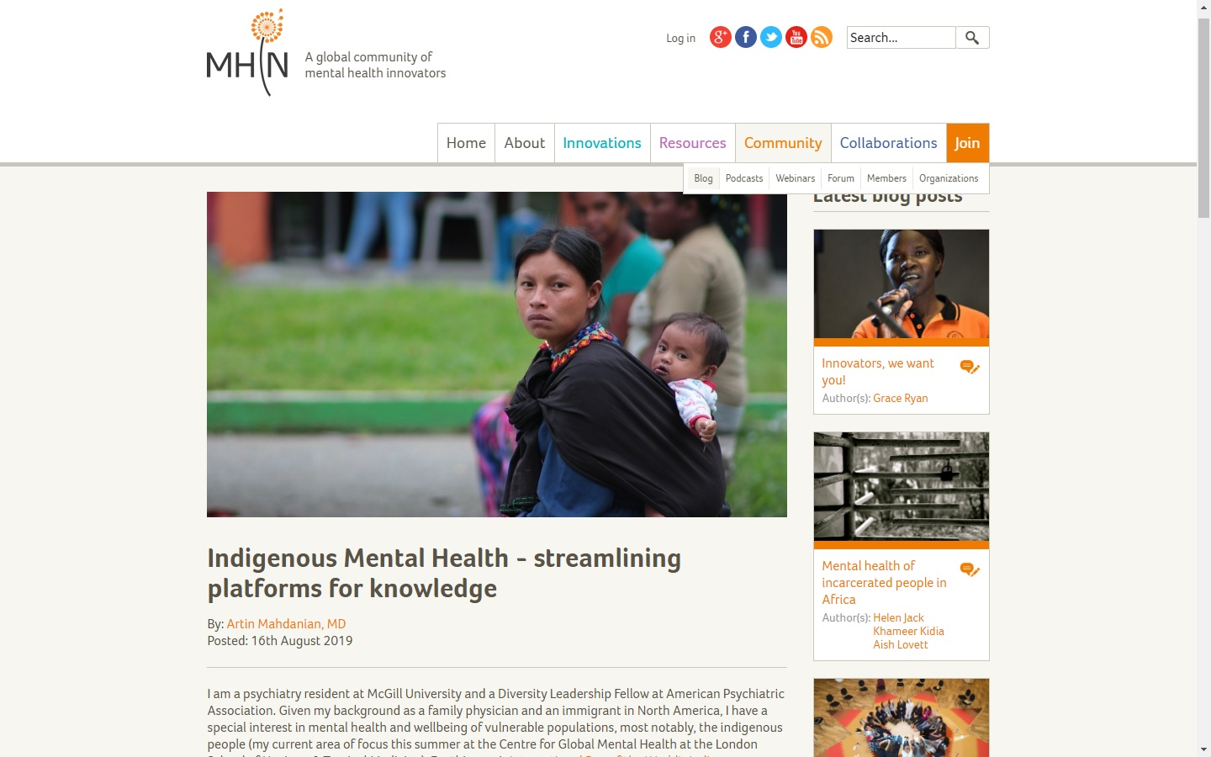

Slide 59
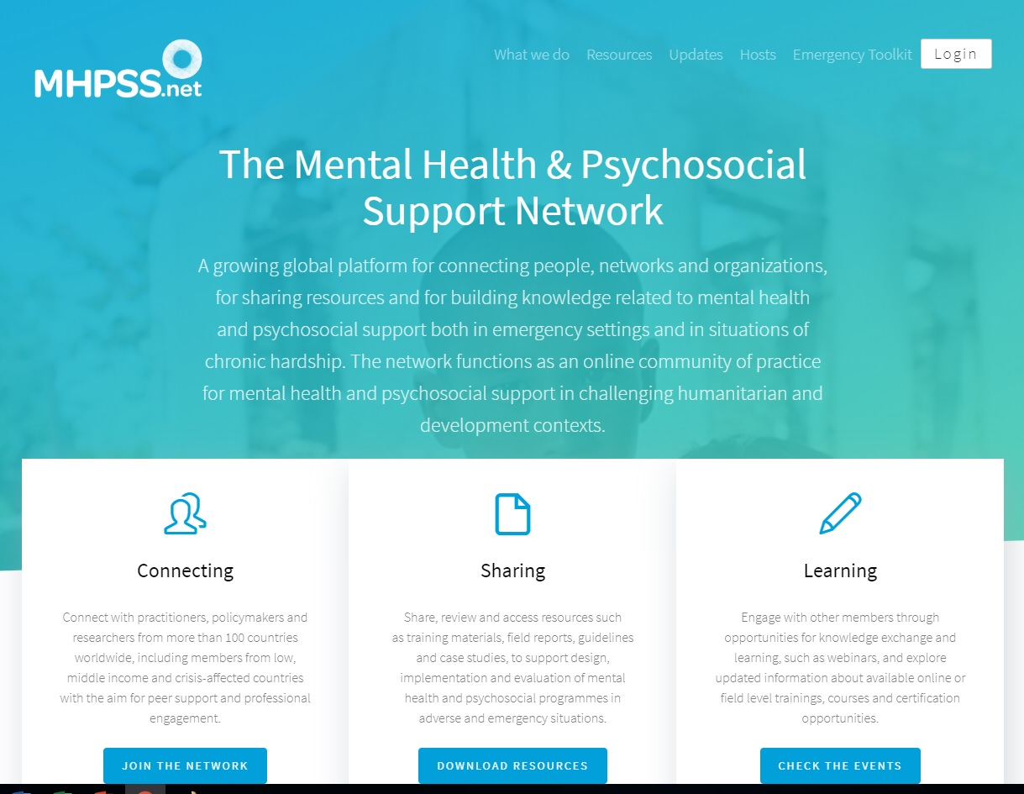
http://www.mhpss.net/

Slide 60

Notes:
In the volume edited by Vikram Patel and his associates (2014), Global Mental Health: Principles and Practice, there are 20 chapters, 512 pp.
Just two of them address child and adolescent mental health and women’s mental health.
Its strength is in articulating principles including epidemiology, culture and mental health, social determinants of health, and health promotion. Key chapters on practice address stigma and promoting political commitment for mental health.
On balance, this volume is stronger on principles than as a guidebook for practice in GMH.
In spite of the enthusiastic blurb from the editor of The Lancet, Global Mental Health is somewhat less than “global” in its reach and something less than affirmative and embracing in its scope.

Slide 61
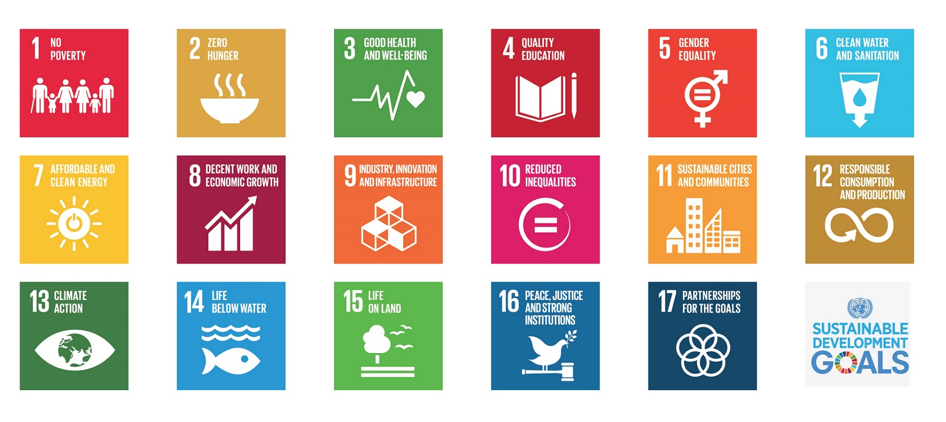
Sustainable Development Goals 2015
2030
https://www.un.org/sustainabledevelopment/sustainable-development-goals/

Slide 62
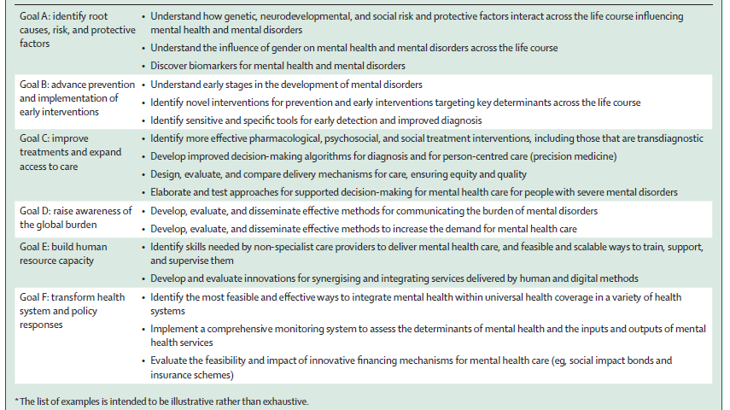

Slide 64
WHO, Project Atlas (V. 2017)
WHO launched Project Atlas in 2001
response to gaps in the collection and dissemination of information about mental health service delivery
“It replaces impressions and opinions with facts and figures” (WHO, 2011, p.7).

Slide 65
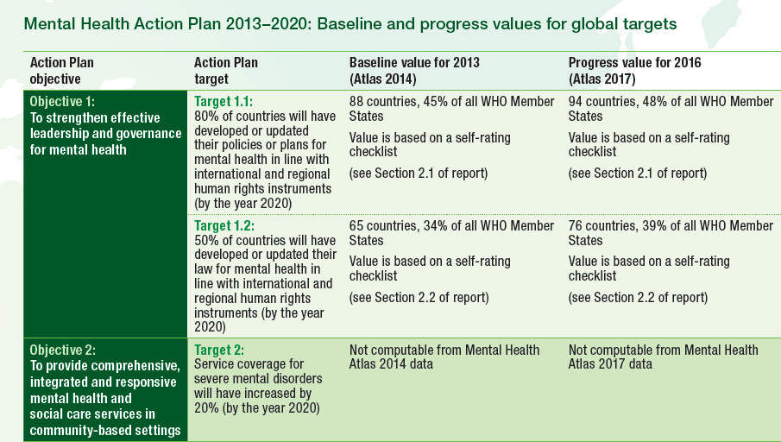

Slide 66
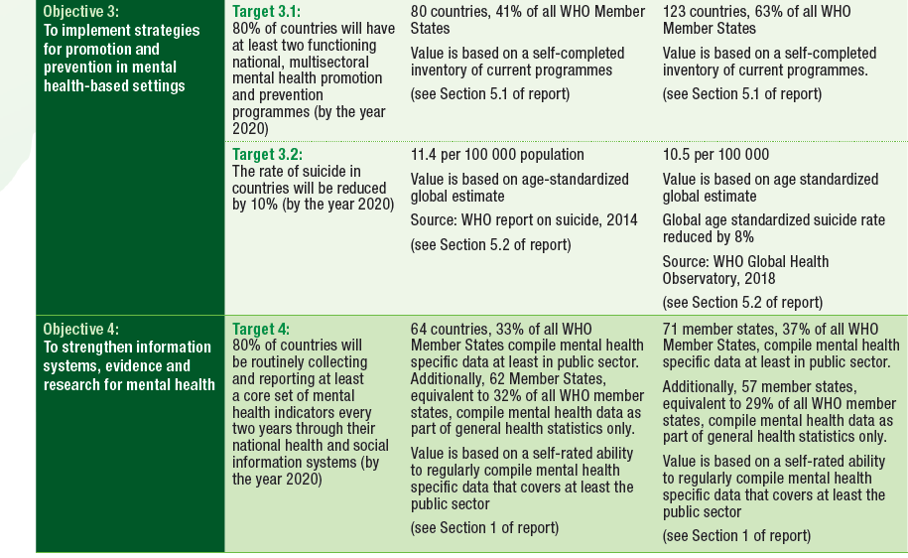

Slide 67
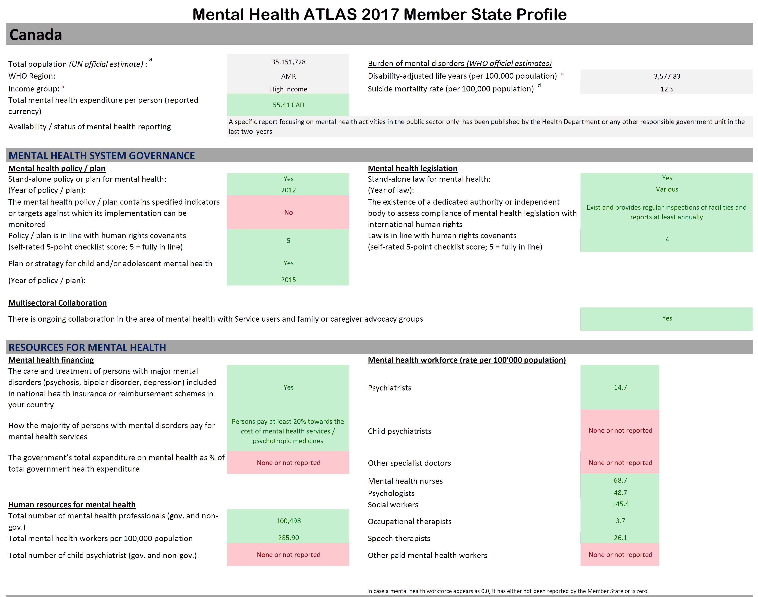

Slide 68
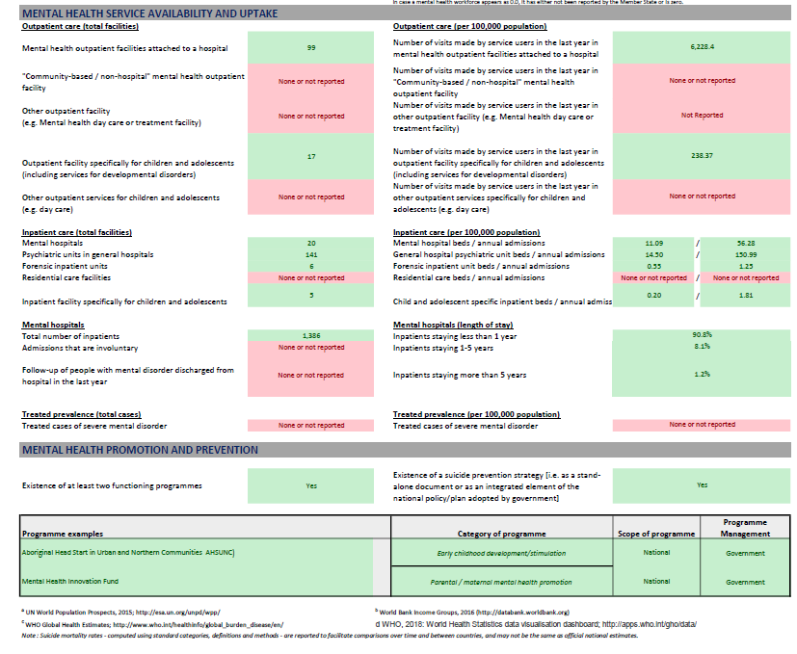

Slide 69
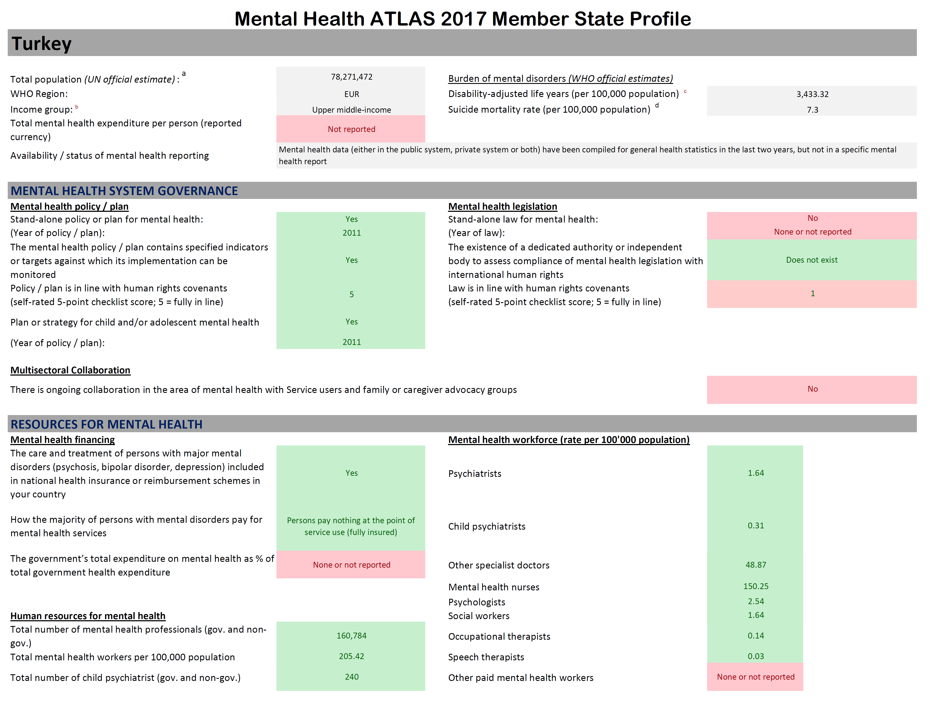

Slide 70
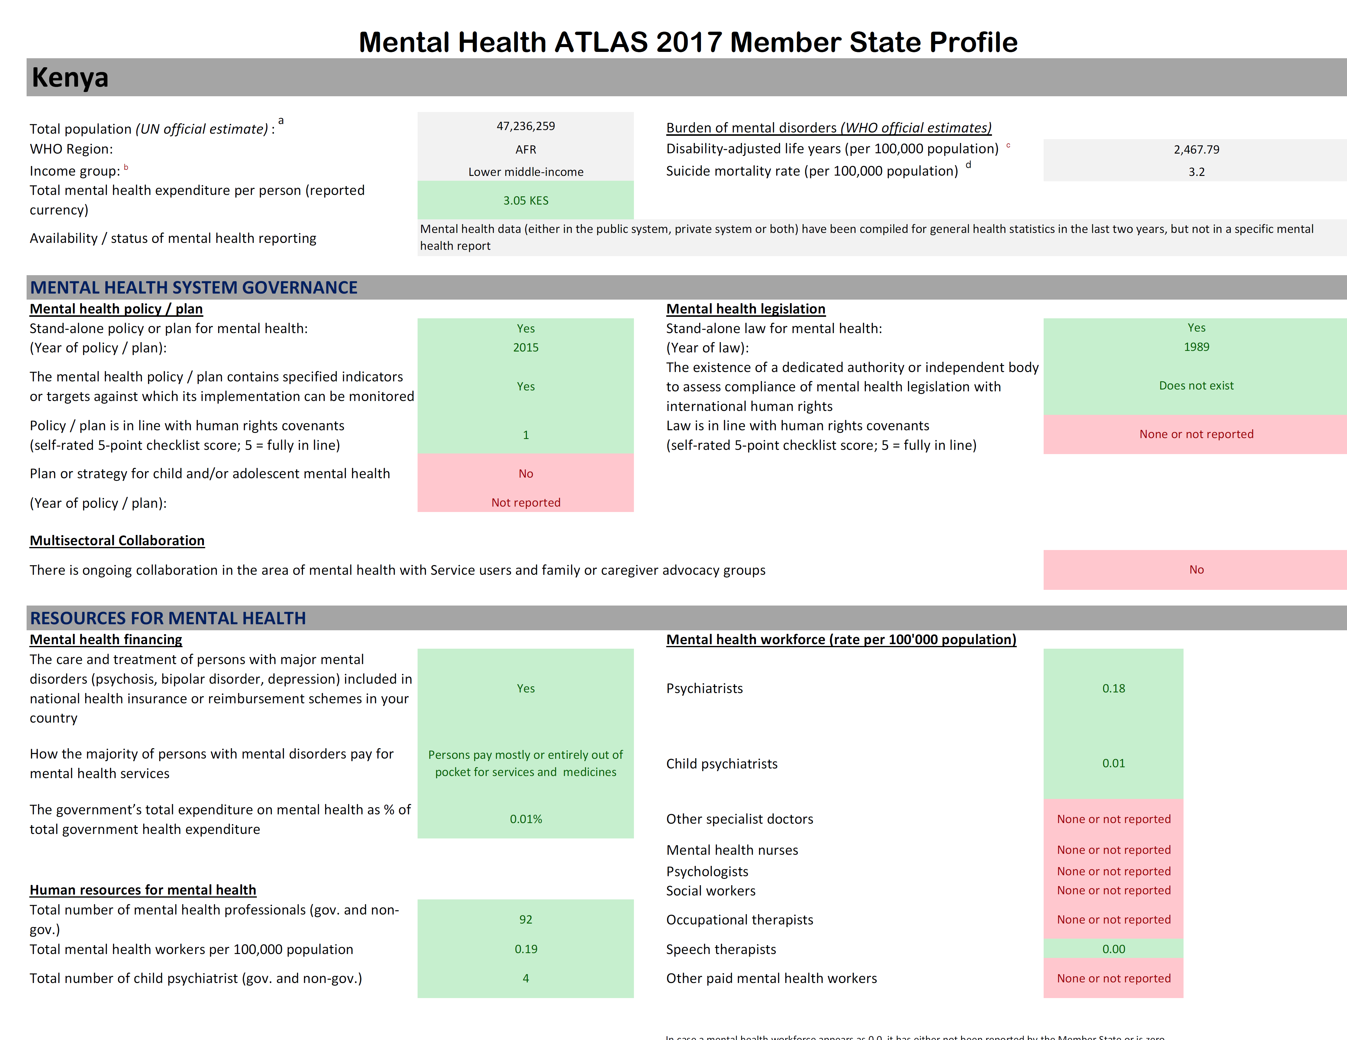

Slide 71
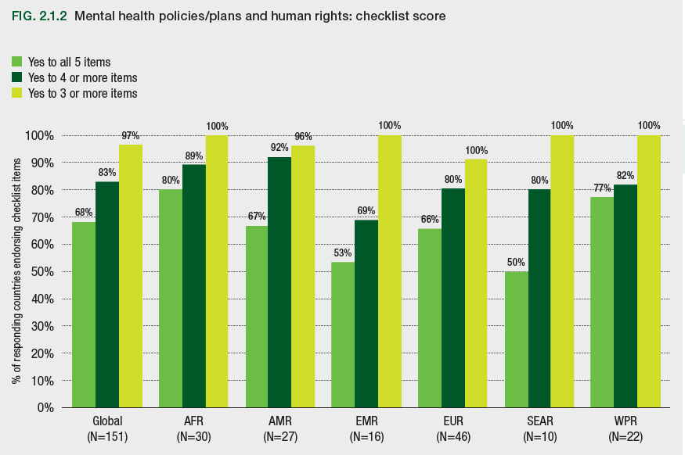

Slide 72
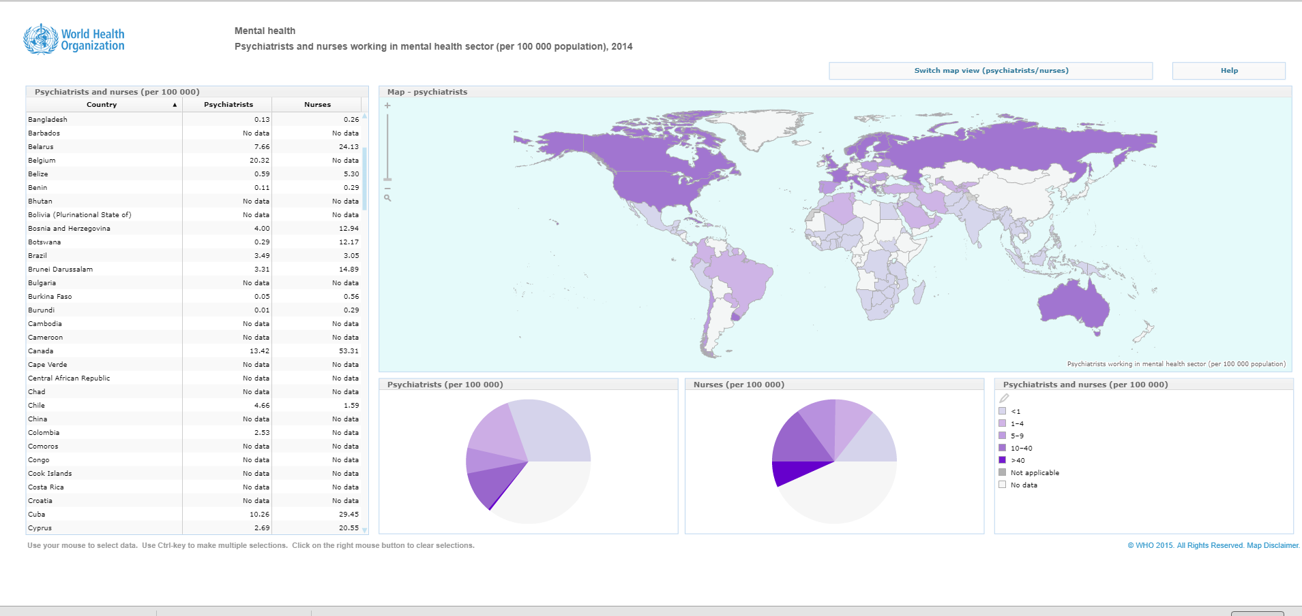

Slide 73
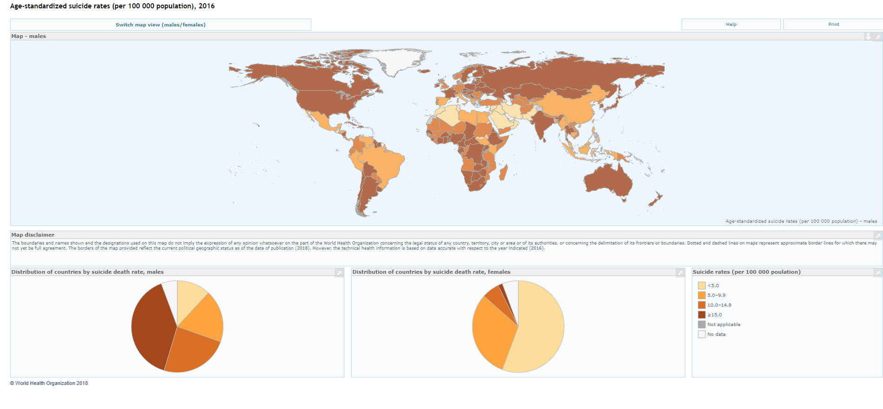
Notes:
The definition, variability, and rarity
of the event in population terms, the nature of its reporting, and the complexity of its causal
pathways make suicide rates a poor indicator of population mental health distress.

Slide 74
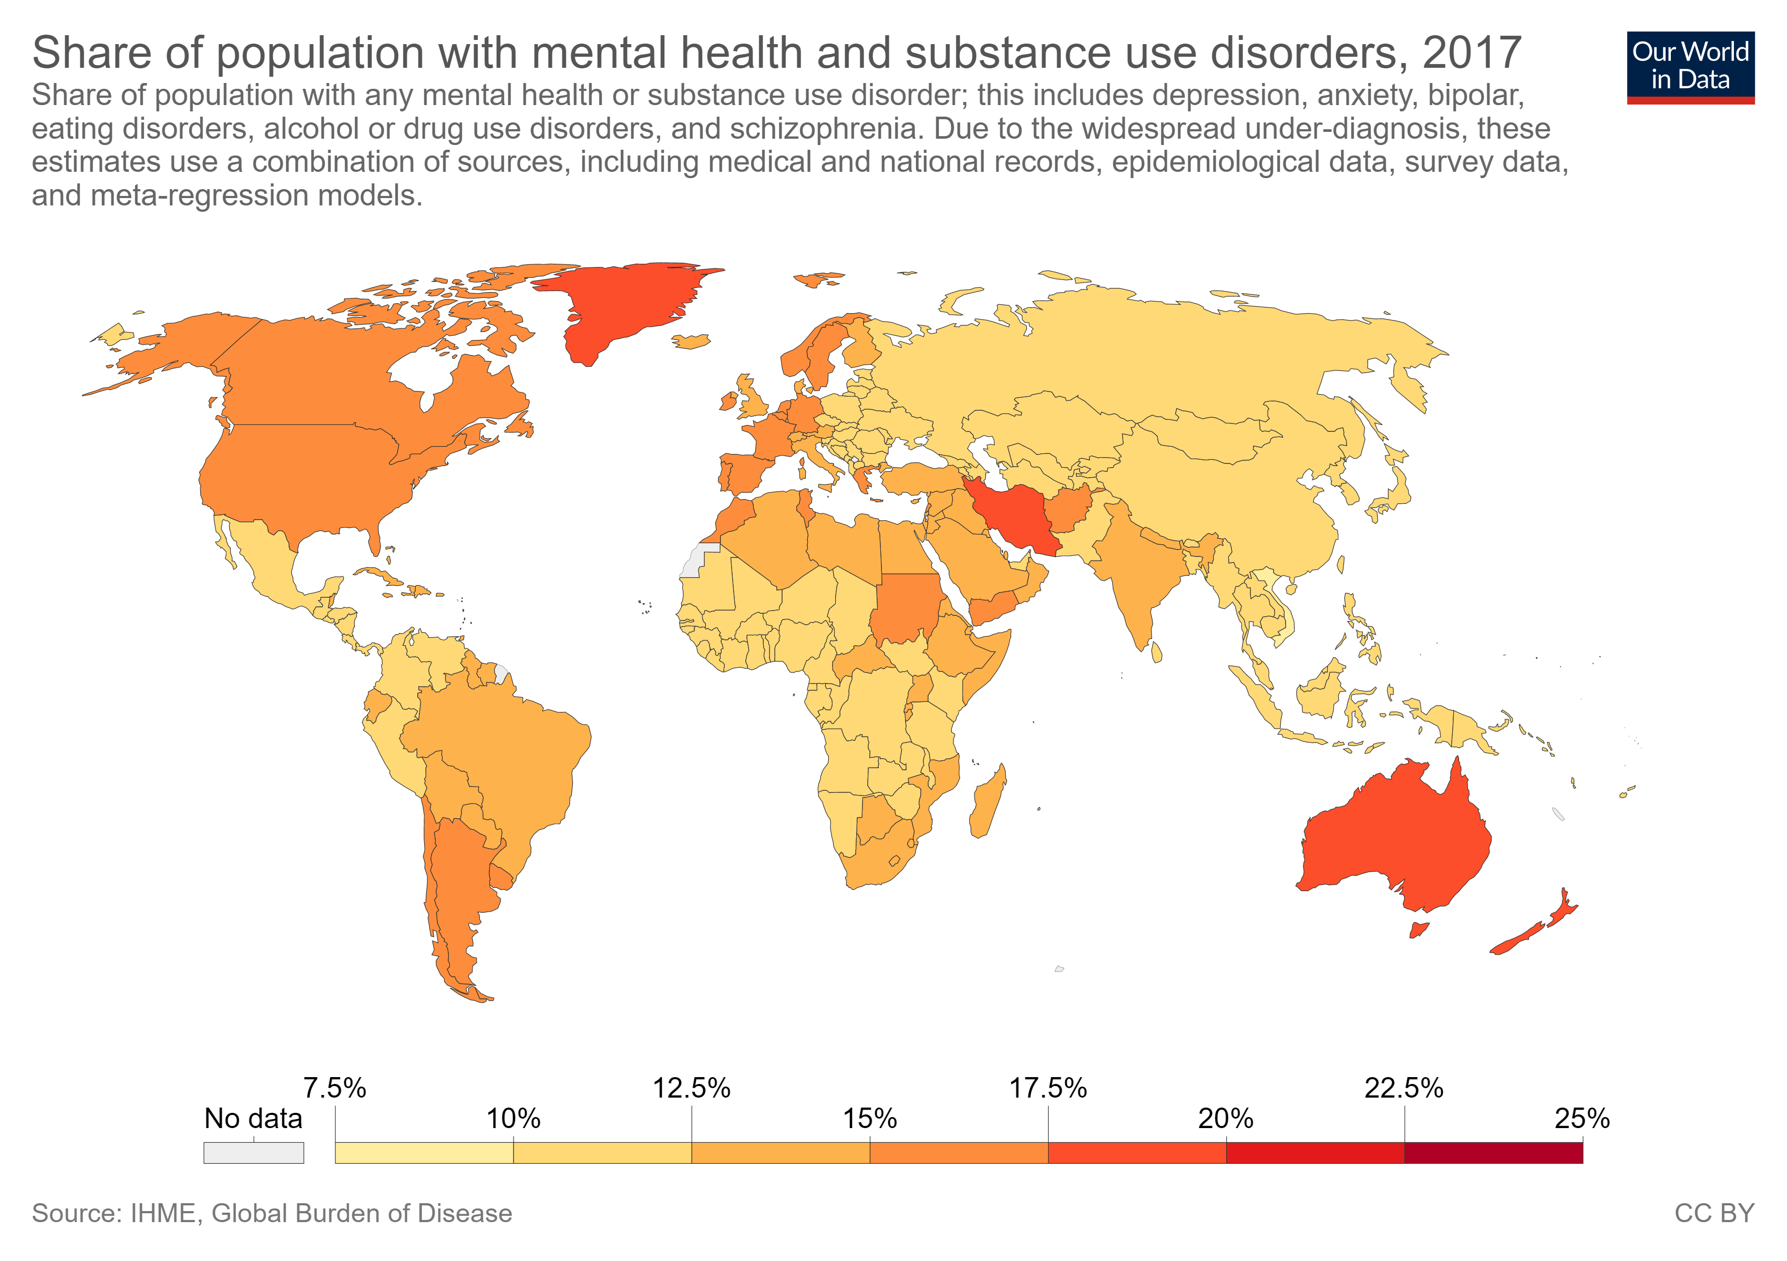

Slide 75
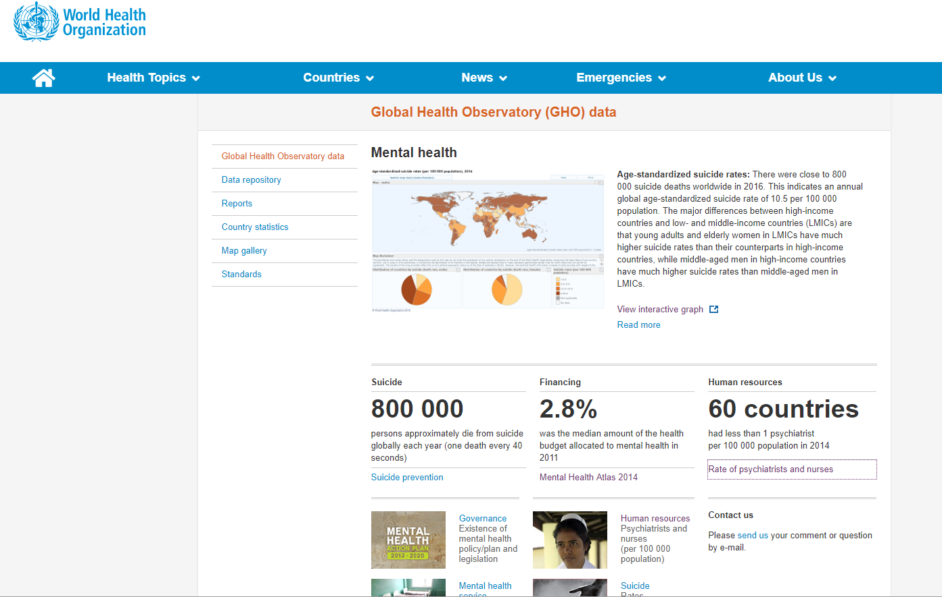
https://www.who.int/gho/mental_health/en/

Slide 76
World Health Organization Efforts
WHO identifies low cost, high impact evidence-based interventions to prevent, promote and treat mental health
working with governments: providing technical material, advice to implement policies, plans, and programs

Slide 77
WHO's Technical Material
Mental Health Atlas
mhGAP-IG
mhGAP training materials
  mhGAP Community Provider Toolkit
Policy guidance package
Quality rights toolkit
ICD-11

Slide 78
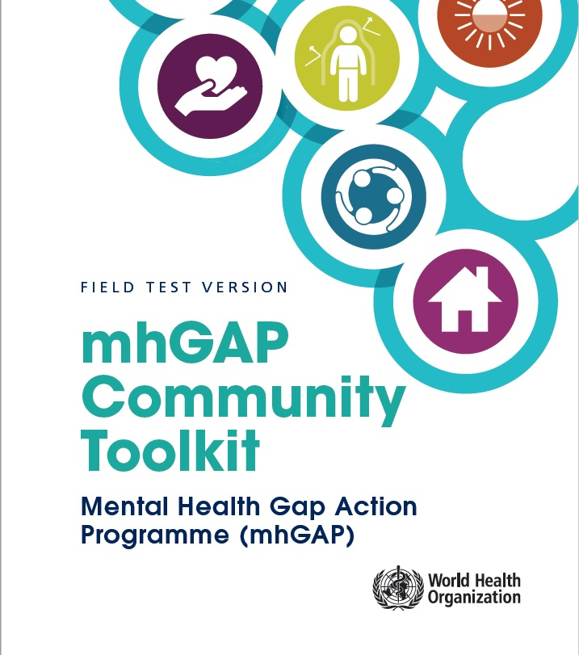
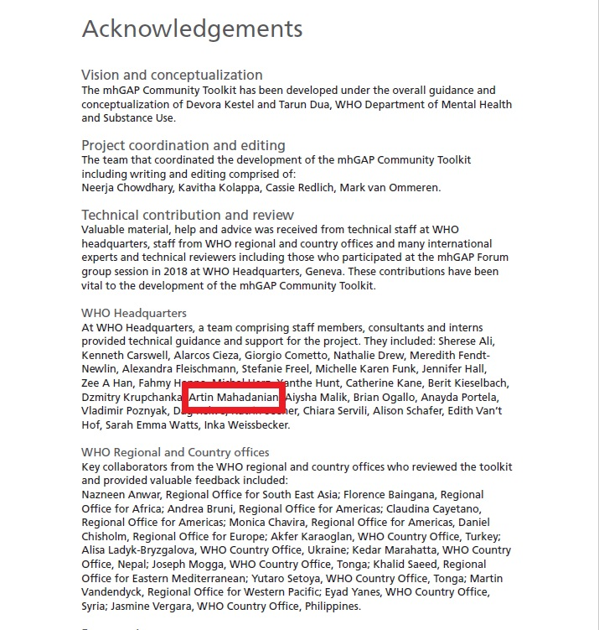

Slide 79
mhGAP Community Toolkit Manual
Module 1: How to talk about mental health
Module 2: How to promote mental health and prevent mental health conditions.
Module 3: How to provide support for people with mental health conditions
Module 4: How to promote recovery and rehabilitation for people with mental health conditions
Module 5: Additional considerations when working in the community

Slide 81
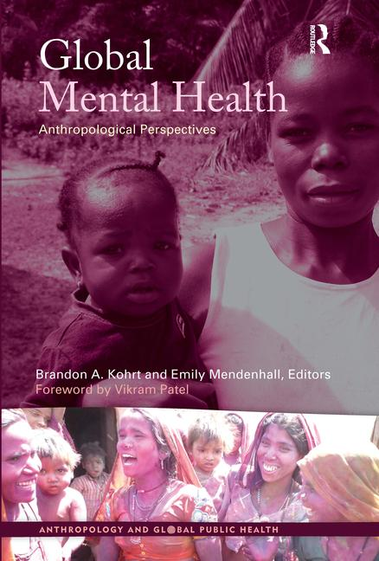

Slide 82
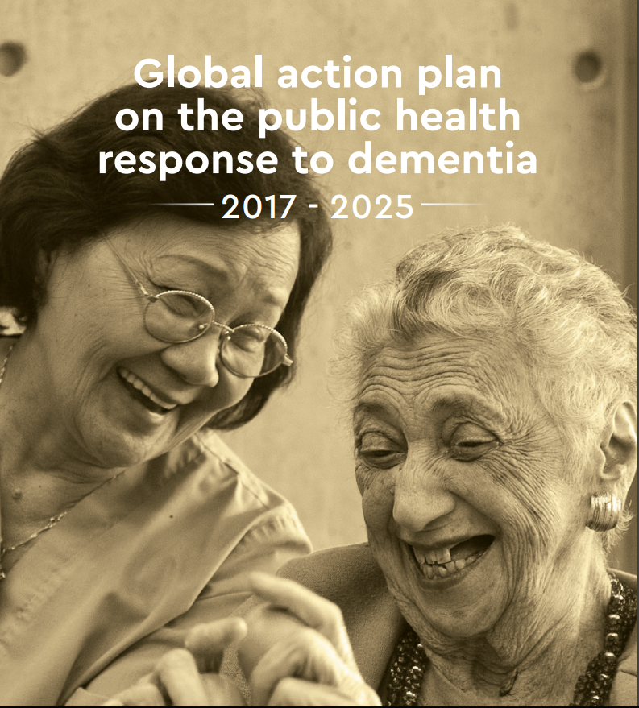

Slide 83
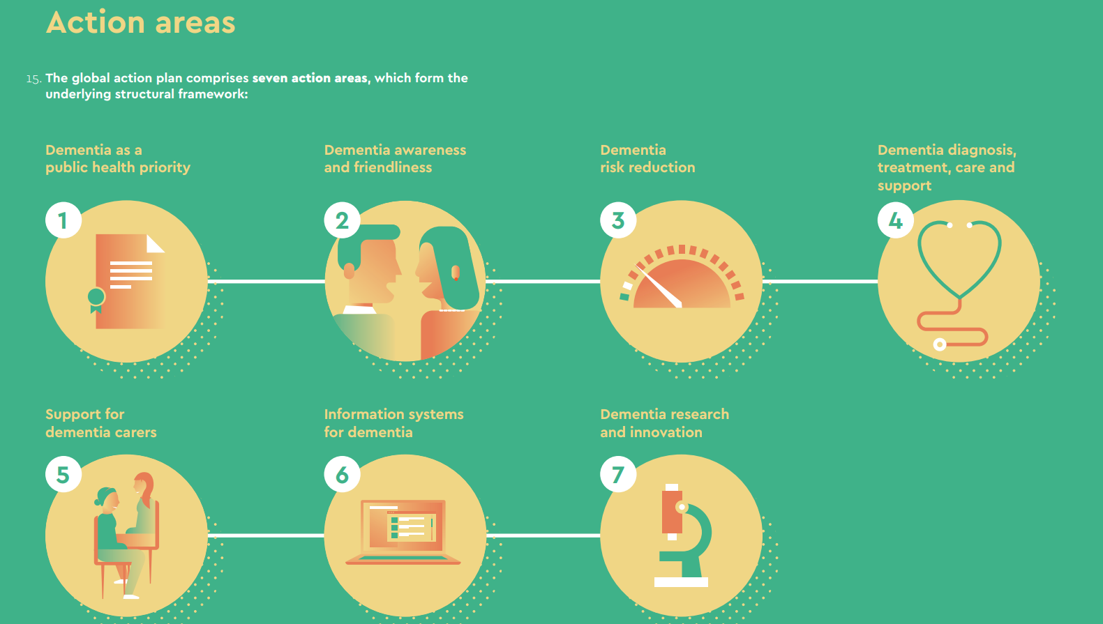

Slide 84
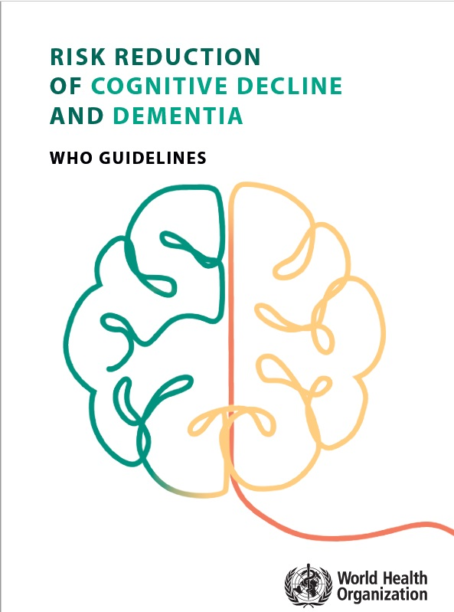
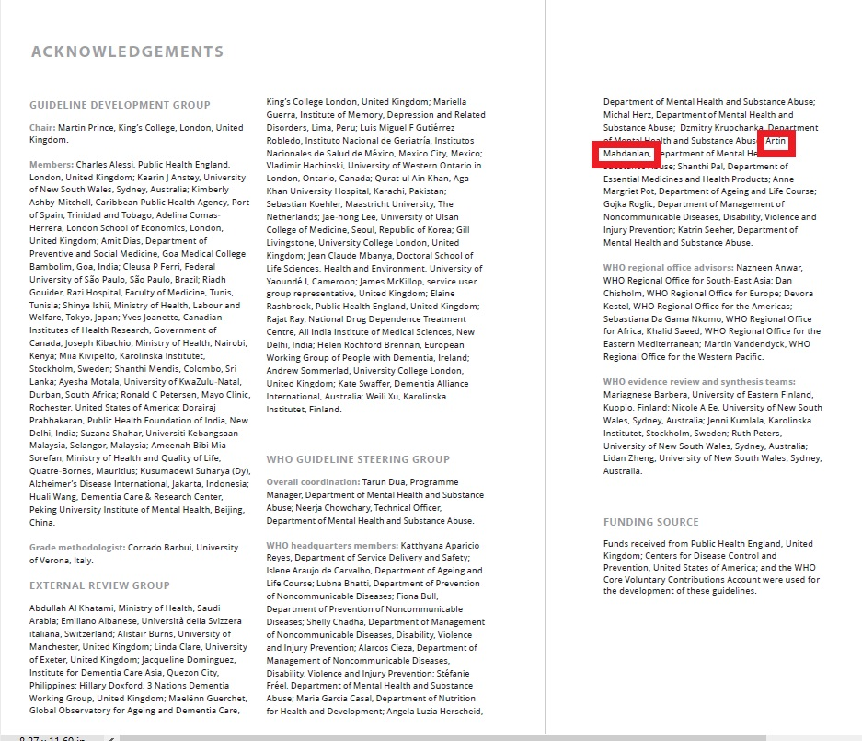

Slide 85
Risk Reduction of Cognitive Decline & Dementia
Recommendation | Level of evidence
Physical activity | Quality of evidence: moderate, Strength of the recommendation: strong
Tobacco cessation | Quality of evidence: low, Strength of the recommendation: Strong
Nutrition | Quality of evidence: Moderate, Strength of the recommendation: Conditional
Alcohol cessation | Quality of evidence: moderate, Strength of the recommendation: Conditional
Cognitive exercise | Quality of evidence: very low to low, Strength of the recommendation: conditional
Social activity | Insufficient evidence
Weight control | Quality of evidence: low to moderate, Strength of the recommendation: Conditional
HTN control | Quality of evidence: high (for some interventions), Strength: strong
DM control | Quality of evidence: very low to moderate, Strength : strong
Dyslipidemia control | Quality of evidence: low, Strength of the recommendation: Conditional
Depression control | Insufficient evidence
Hearing loss control | Insufficient evidence

Slide 86
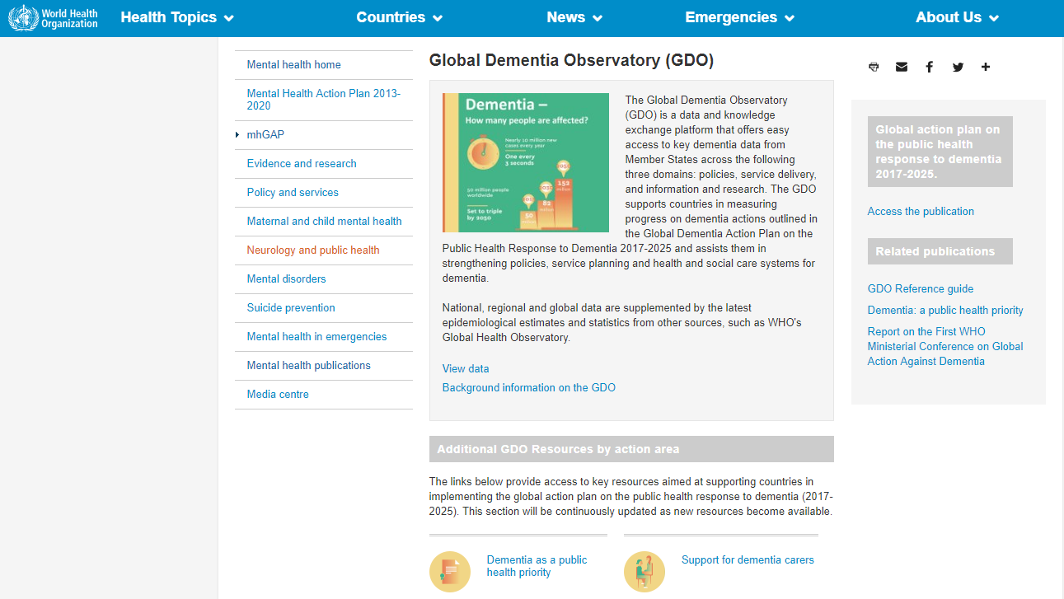

Slide 87
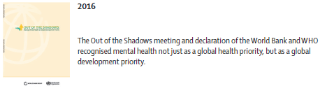
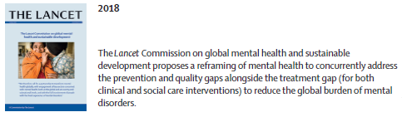

Slide 88
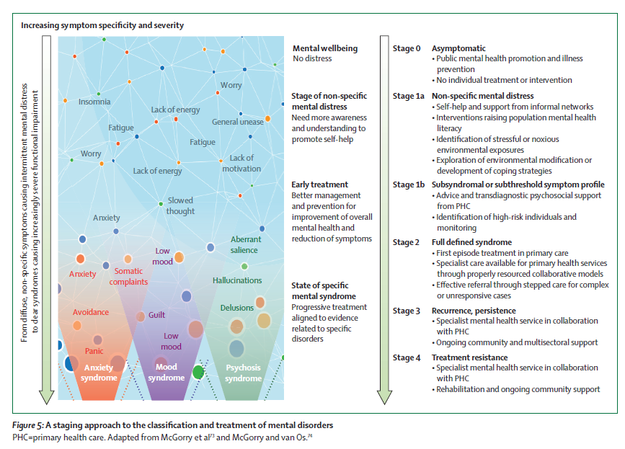

Slide 89
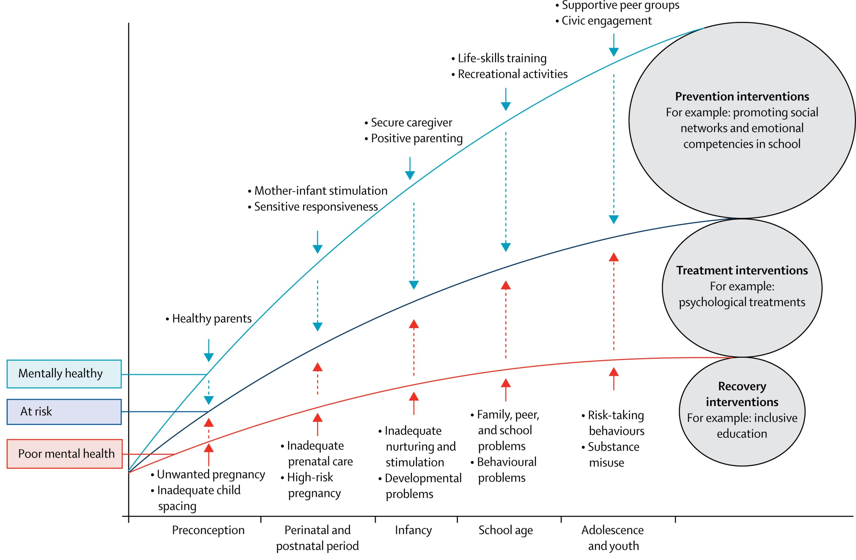
Notes:
The Lancet Commission acknowledges there is a spectrum to mental health, with different risk factors across the life course and different kinds of interventions required across that spectrum.

Slide 90
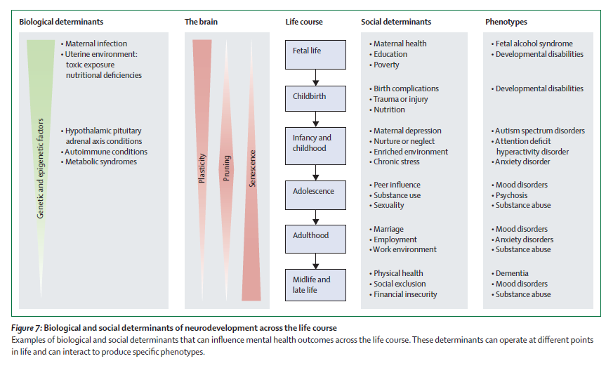

Slide 91




















Other Actors in GMH as of 2019
Notes:
Great majority has been academic
Changing now to institutes of PH, funding bodies
In countries, disproportionate power in tertiary hospitals, sometimes university med schools
Important not to forget NGOs
Service user organisations – more recognised than ever, many countries now developing
Also NEW – not WPA, WFMH, APA, RCPsych

Slide 92
Other Activities in GMH
Blue Print Group in Global Mental Health:
funded by the Welcome Trust and coordinated by United for GMH to encourage greater global collaboration on mental health advocacy and communications.
Email: Anna Watkins to join (anna@unitedgmh.org)
Speak Your Mind — A Global Campaign for Mental Health:
Run by United for GMH sharing powerful messages to raise the profile of MH
World Economic Forum (WEF), Davos:
Mental health was highly visible at Davos, including major media coverage and stories, a panel session, a press conference and a Mental Health Matters plenary session

Slide 93
Other Activities in GMH
United Nations General Assembly:
2018 first ever United Nations side-event dedicated to mental health by enlisting the support of BPG members including the Government of Canada, Born This Way Foundation and many other supporting organizations
Global Ministerial Mental Health Summit :
2018 held in London, 2019 in Amsterdam as an effort in prioritising mental health, achieving parity between mental and physical health
WHO mhGAP Forum:
Accelerating Actions on Global Mental Health
World Health Assembly:
BPG advocated for greater action on mental health: specifically for integration of mental health in Universal Health Coverage

Slide 94
Public Mental Health / Public Psychiatry
Prevention of mental illness
Promotion of mental health
Recovery, rehabilitation and community psychiatry
Life course approach
    Programmes for perinatal care, infants & toddlers, parenting skills (reduce ACE)
    Education policies and school programs (Life skills, reduce bully)
    Employment and labour policies (fair employment, …)
    Policies for poverty, housing and social exclusion
    Policies to prevent depression, anxiety and suicide
    Prevention of harmful substance use
    Aging-friendly policies
    Stigma reduction policies
Notes:
Mental health promotion aims to protect, support and sustain emotional and social well-being
and create individual, social and environmental conditions that enable optimal psychological and
psycho-physiological development, enhance mental health, while showing respect for culture,
equity, social justice and personal dignity. Initiatives involve individuals (at risk, suffering, or
recovering from mental health problems), in the process of achieving positive mental health,
enhancing quality of life and narrowing the gap in health expectancy between countries and groups.
To “prevent” literally means “to intervene or to take steps in advance to stop something from
Happening”. Mental disorder prevention focuses on reducing risk factors and enhancing protective
factors associated with mental ill-health, with the aim of reducing risk, incidence, prevalence and
recurrence of mental disorders, the time spent with symptoms, or the risk condition for a mental
illness, preventing or delaying recurrences and also decreasing the impact of illness in the affected
person, their families and society.

Slide 95
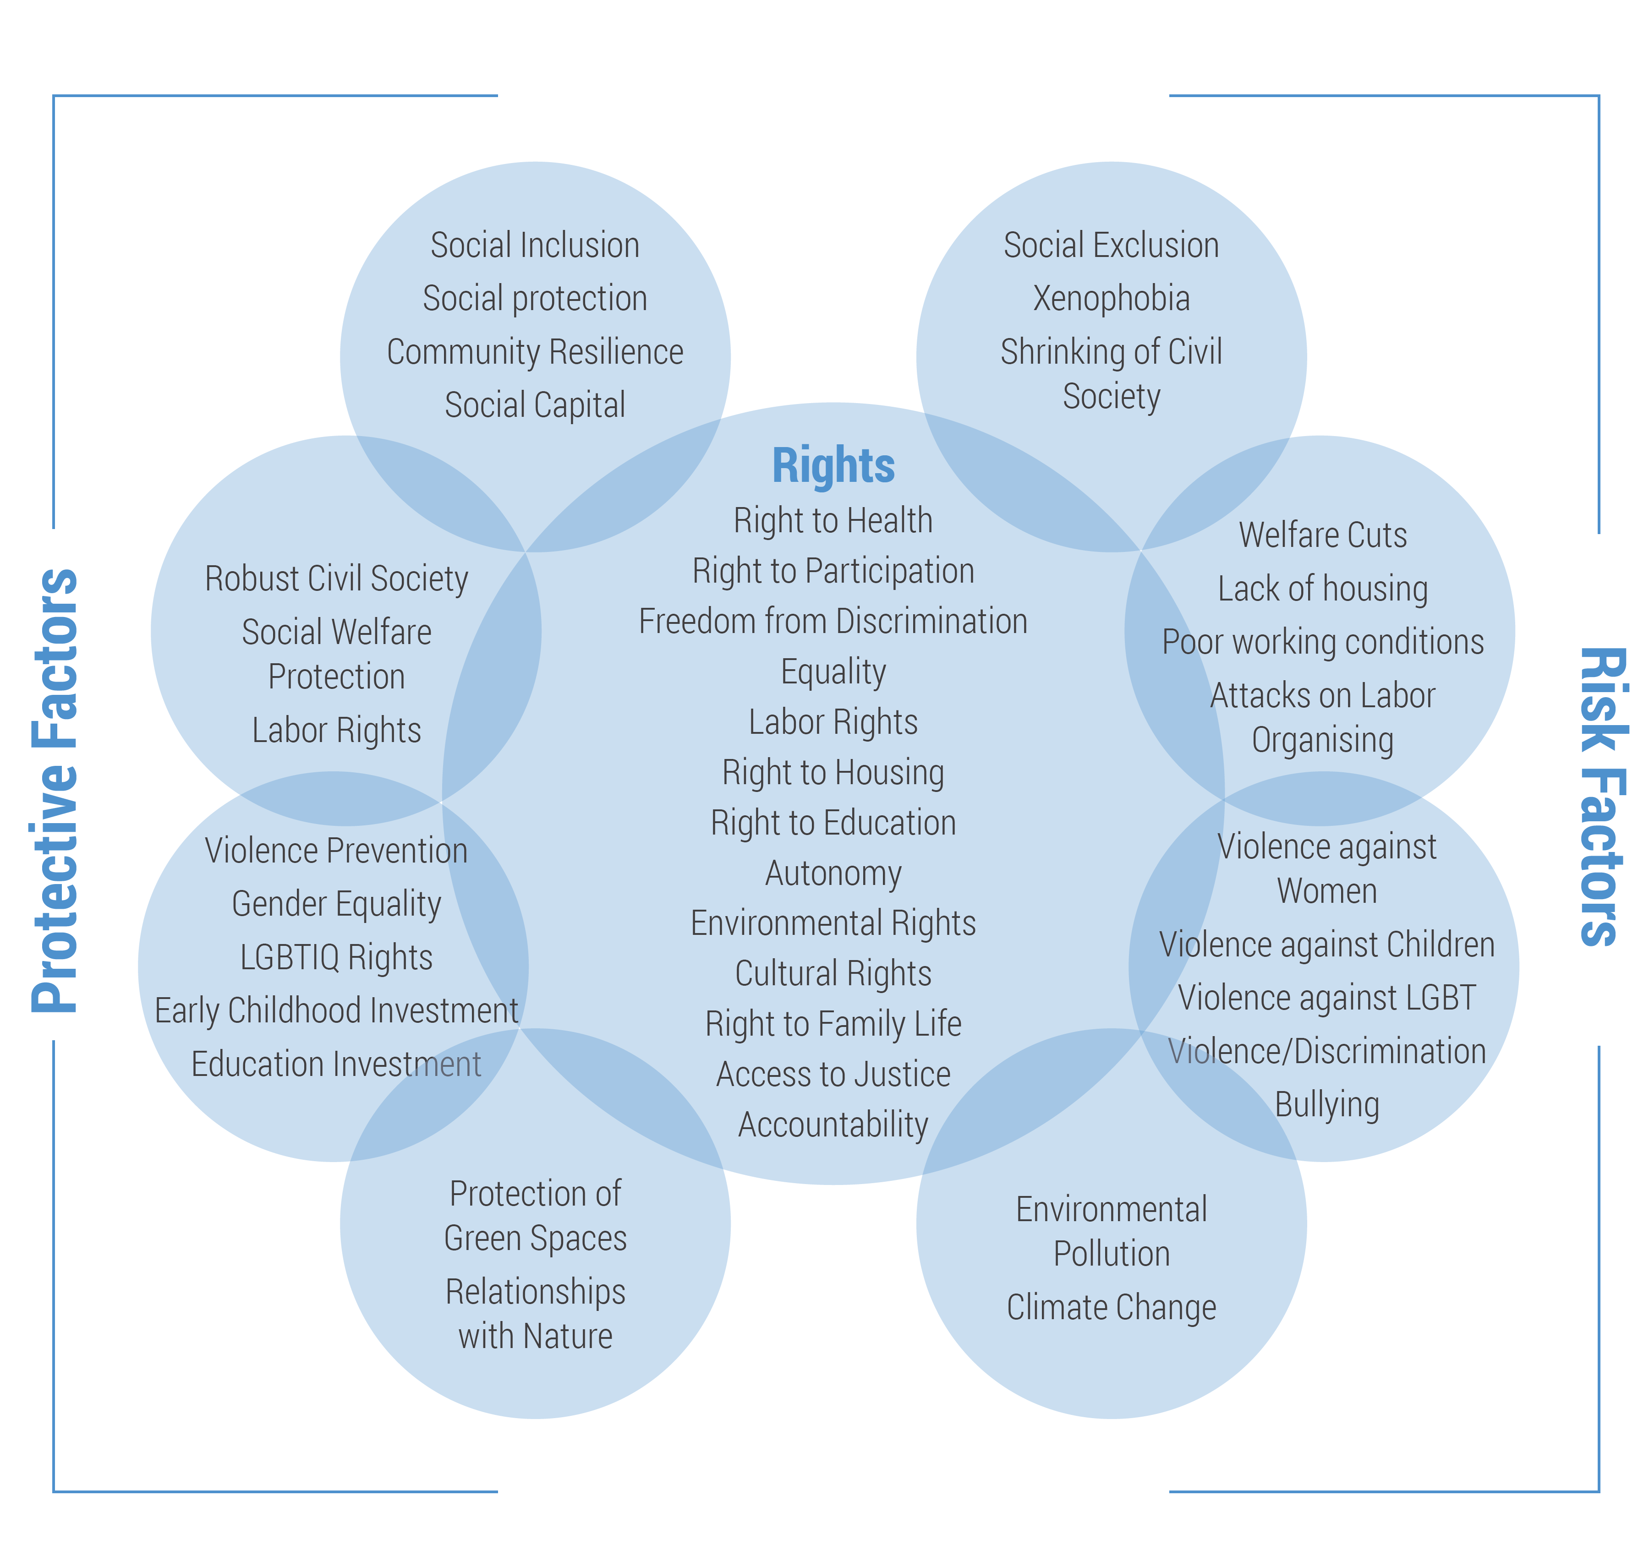

Slide 96
Interventions
Early childhood interventions (e.g., Home visiting for pregnant women, prevention of alcohol abuse by mothers, preschool psychosocial interventions, combined nutritional and psychosocial interventions for disadvantaged populations)
Support to children (e.g., Life-skills programs, child and youth development programs, Supporting ecological changes in schools, child-friendly schools)
Socioeconomic empowerment of women (e.g., improving access to education)

Slide 97
Interventions (cont.)
Social support for older populations (e.g., Befriending initiatives, community and day centers for older adults)
Programs targeting vulnerable groups including minorities, indigenous people, migrants, and those affected by conflicts and disasters (e.g., Psychosocial interventions after disasters)

Slide 98
Interventions (cont.)
Mental health interventions at work (e.g., Stress prevention)
Housing policies (e.g., Housing improvement)
Violence prevention programs (e.g., Community policing initiatives)
Community development programs (e.g., “Communities that care” initiatives, integrated rural development)

Slide 99


Slide 100
“Justification for using coercion is generally based on “medical necessity” and “dangerousness”. These subjective principles are not supported by research and their application is open to broad interpretation, raising questions of arbitrariness that has come under increasing legal scrutiny. “Dangerousness” is often based on inappropriate prejudice, rather than evidence.”

Slide 101

Networking, Advocacy, Collaboration

Slide 102


Slide 103

Think Global, Work Local

Slide 104
Human Rights Violations
Lack of access
  Some countries may lack adequate services; others may limit access to certain population segments.
  32% of countries have no community care facilities
  30% of countries have no specified budget for mental health; of those that do, 20% spend less than 1% on mental health
  Number of psychiatrists ranges from 10 per 100,000 to 1 per 300,000
WHO recommendation: mental health care should be available at the community level for anyone who needs it

Slide 105
Human Rights Violations, cont.
Inappropriate forced admission or treatment
  Informed consent
  People are forced against their will in mental health facilities.
  WHO recommendation: informed consent must form the basis of all mental health care; rigorous and ongoing procedural safeguards need to be in place to protect against abuse of involuntary admission and treatment

Slide 106
Human Rights Violations, cont.
Violations within psychiatric institutions:
  People restrained with metal shackles, caged beds, other inhumane treatment
  People living in filthy conditions, lacking clothes, food, heating, proper bedding, or hygiene facilities
  People isolated from society in large institutions, far from family and loved ones
WHO recommendation: countries should set up monitoring bodies to ensure that human rights are being respected in all mental health facilities

Slide 107
Human Rights Violations, cont.
Inappropriate detention in prison:
  In some countries people with mental disorders are in prison due to a lack of mental health services or lack of a diagnosis/treatment for their condition; “prisoners” continue to go unnoticed, undiagnosed, untreated
WHO recommendation: people with mental disorders should be diverted away from criminal justice systems and toward mental health services

Slide 108
Human Rights Violations, cont.
Stigma, discrimination and violations of basic rights
  People often deprived of civil rights (right to vote, marry, have children)
  People experience discrimination in all areas of life (employment, education, right to shelter)
WHO recommendation: people with mental disorders have the same human rights as everyone else; due to vulnerability, countries have a responsibility to protect them from discrimination

Slide 109
Critics of GMH

Slide 110

“Should not replicate the inefficient, inaccessible, and insensitive Western model”

Slide 111

Notes:
American journalist Ethan Watters’ Crazy Like Us: The Globalization of the American Psyche (2010) criticizes the notion of exporting US notions of health and illness around the world, posing a key critique with his provocative title. I agree that all notions of health and wellbeing, illness and disease have a distinct human history and cultural geography. By this I mean that these notions are not merely biological givens, evolving over time and taking different shapes under the influence of social and cultural determinants.

Slide 112
Crazy Like Us
American journalist Ethan Watters’ crazy like us: the Globalization of the American Psyche criticizes the idea of exporting Western notions of health and illness around the world, posing a key critique with his provocative title
All notions of health and wellbeing, illness and disease have a distinct human history and cultural geography. These notions are not merely biological. They evolve over time and taking different shapes under the influence of social and cultural determinants
Notes:
Two thoughtful and well-researched books critical of GMH.

Slide 113

Notes:
China Mills’ (2013) more scholarly critique, Decolonizing Global Mental Health: The Psychiatrization of the Majority World, raises similar problems by placing GMH itself in a global perspective, including the perspectives of critical political theory and post-colonialism.
There are many mentions of radical critical thinkers in the social sciences, politics, and colonialism, e.g., the Caribbean psychiatrist and revolutionary Frantz Franon is amply discussed.
Mills is especially critical of a key GMH notion of “health gaps,” but that is a separate issue.

Slide 114
Decolonizing Global Mental Health
China mills’ (2013) more scholarly critique, decolonizing global mental health: the psychiatrization of the majority world, raises similar problems by placing GMH itself in a global perspective, including the critical political theory and post-colonialism.
There are many mentions of radical critical thinkers in the social sciences, politics, and colonialism, e.g., the Caribbean psychiatrist and revolutionary Frantz Fanon.
Mills is especially critical of a key GMH notion of “health gaps”.

Slide 115
Critics of mhGAP
Central weakness: assumption that these are ‘diseases’ of brain.
Evidence for biological causes for mental illnesses remain fairly weak (Nestler et al., 2002; Stahl, 2000).
Limited focus on the potential role of social and cultural factors
Risks of psychiatric medications

Slide 116
Critics of mhGAP
The predominance of ‘western’ frames of reference for categorising and measuring mental health difficulties mean that the evidence-base for mental health interventions is not universally valid for the global population (Summerfield, 2008).
The cross-cultural validity of the diagnoses of depression is questionable. The apparent rise in prevalence of depression across the globe is a ‘pseudo-epidemic’ (Summerfield, 2006).
Higher rates of chronic disability associated with SPMI/suicide in high-income countries, despite much higher access to resources, suggests that something essential to recovery is missing in the social fabric (Jablensky & Sartorius, 2008).

Slide 117
Acknowledgements
McGill University: Psychiatry Dep. and Transcultural Div.
Dr. Laporta, Dr. Tourian, Dr. Looper, Dr. Kirmayer
WHO: Devora Kestel, Dr. Neerja Chowdhary, Dr. Katrin Seeher, Dr. Tarun Dua and other team members
LSHTM/MHIN/CGMH: Dr. Julian Eaton, Onaniza Qureshi and other team members
APA International Psychiatry Council and GMH Caucus: Dr. Eliot Sorel / Dr. James Griffith / Dr. Brandon Kohrt/ Dr. Bibhav Acharya and other team members

Slide 118



am@globalmentalhealth.net

